Slide 1
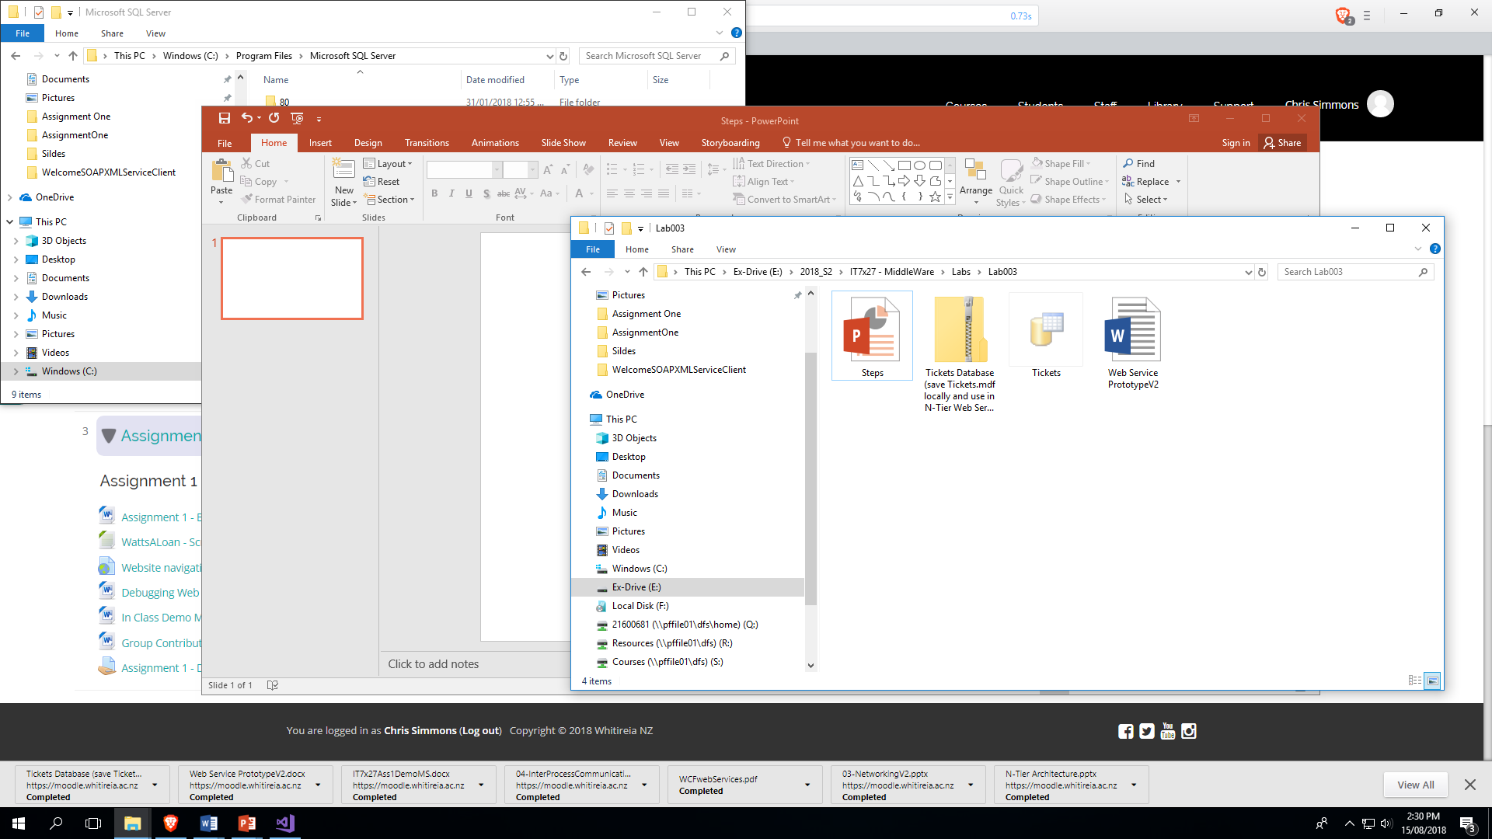

Slide 2
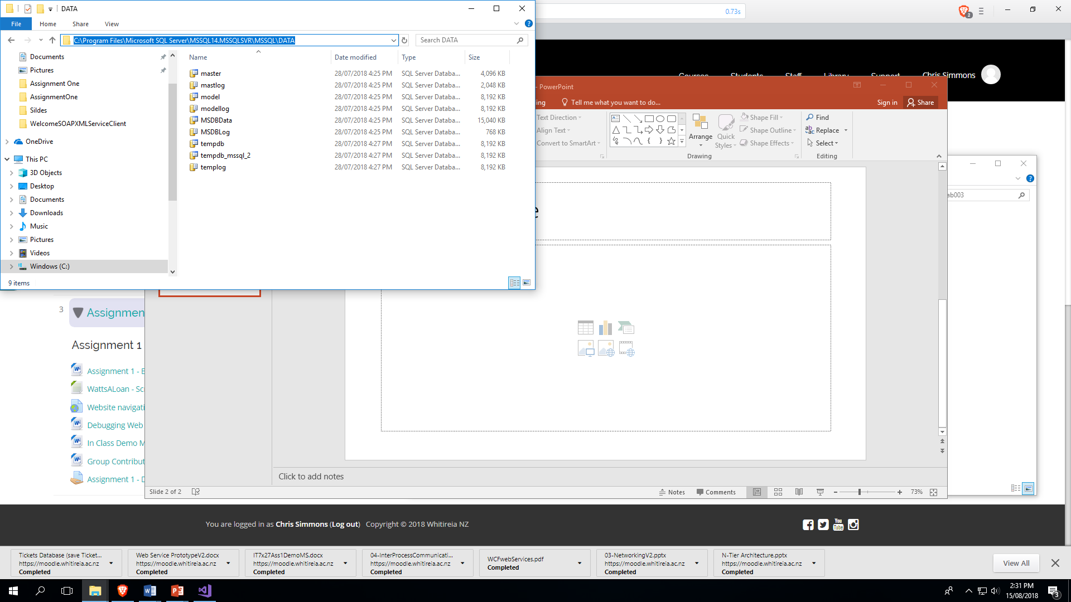

Slide 3
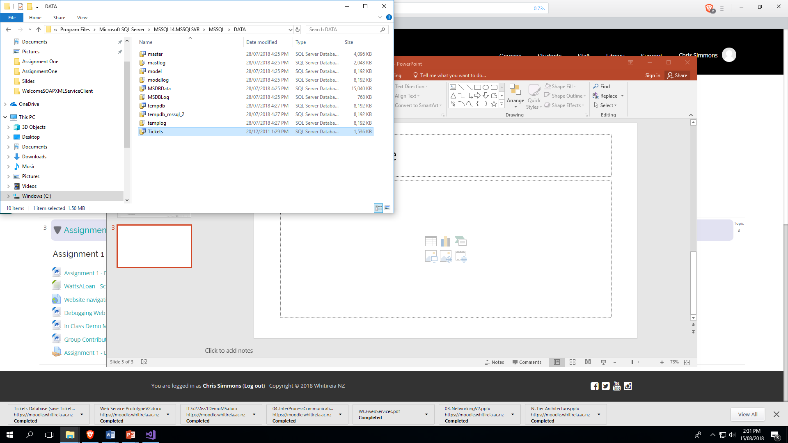

Slide 4
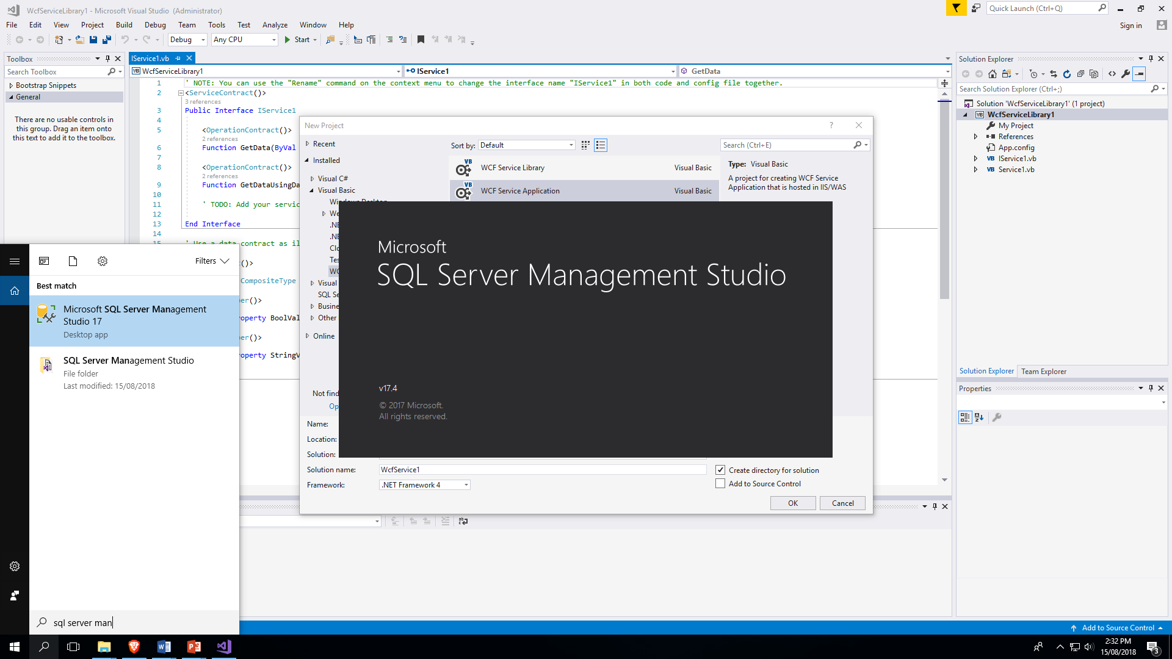

Slide 5
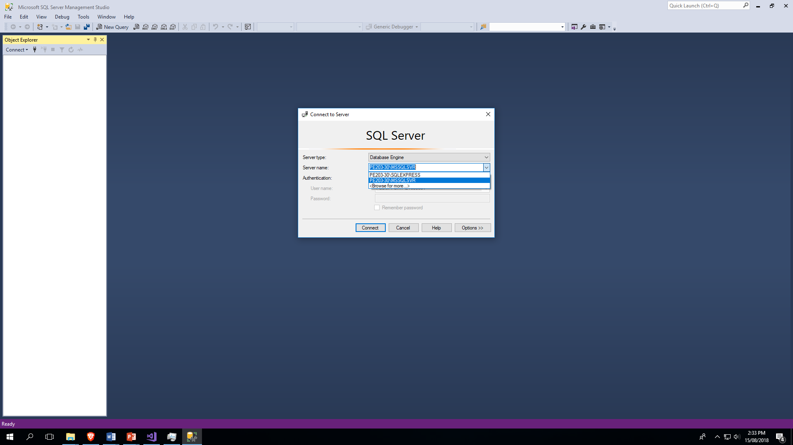

Slide 6
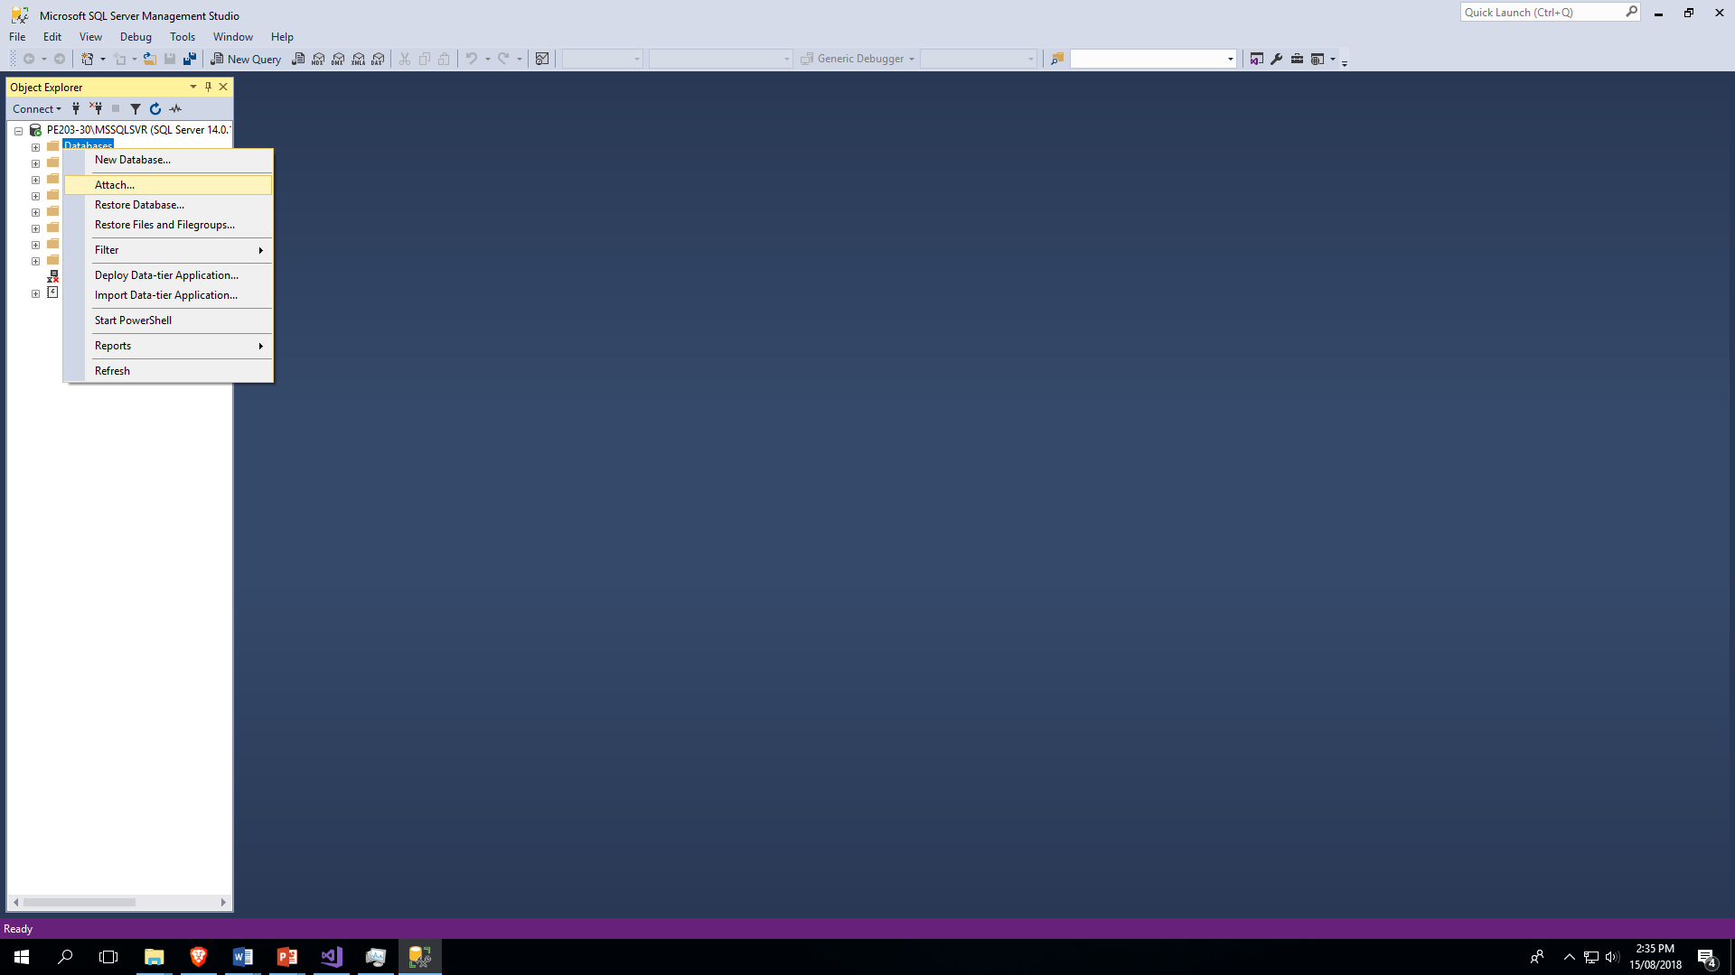

Slide 7
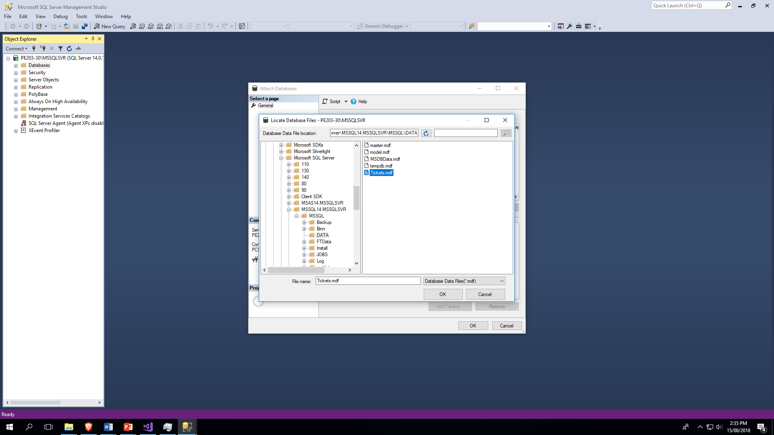

Slide 8
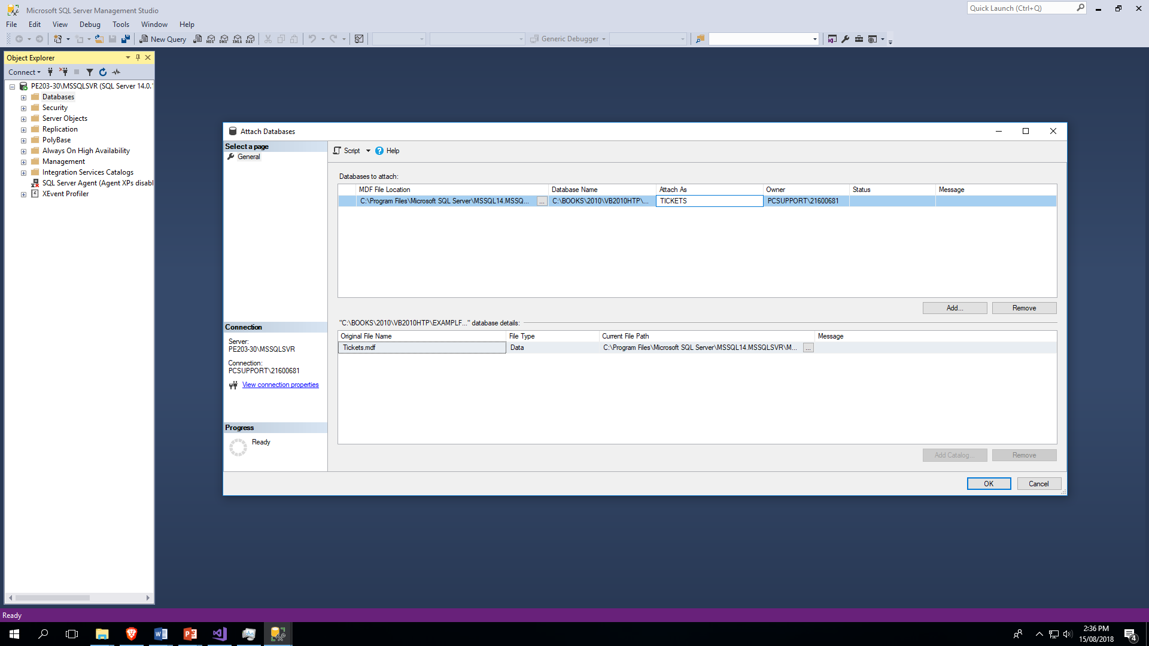

Slide 9
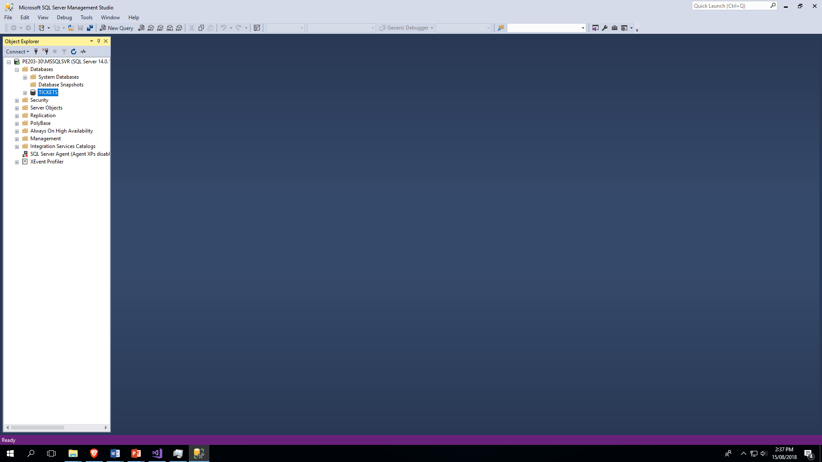

Slide 10
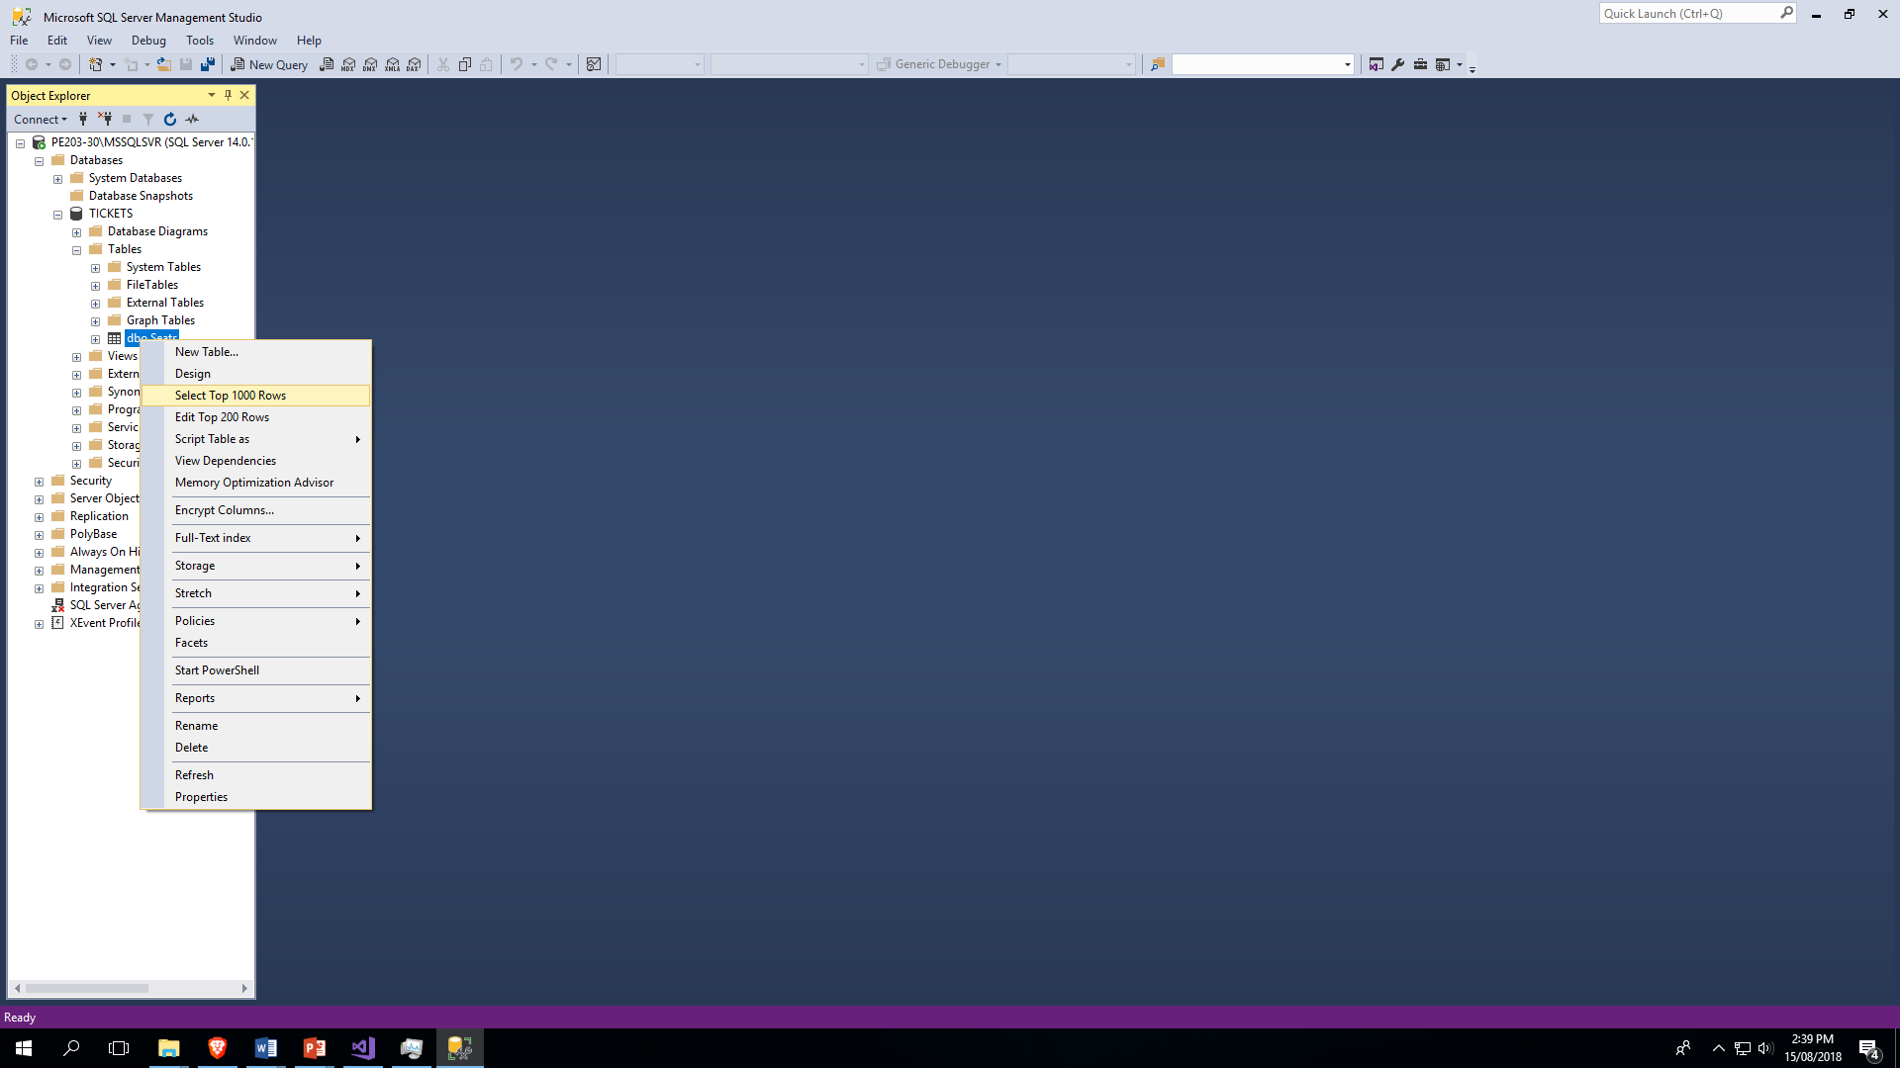

Slide 11
USE [TICKETS] GO /****** Object: StoredProcedure [dbo].[Reserve] Script Date: 20/12/2013 1:11:09 p.m. ******/ SET ANSI_NULLS ON GO SET QUOTED_IDENTIFIER ON GO -- ============================================= -- Author: <Author,,Name> -- Create date: <Create Date,,> -- Description: <Description,,> -- ============================================= CREATE PROCEDURE [dbo].[Reserve](@seatType varchar(50), @classType varchar(50), @Response bit OUTPUT) AS BEGIN DECLARE @Count as integer DECLARE @Result as bit = 0 SELECT @Count = count(Number) FROM Seats WHERE Seats.Type = @seatType AND Seats.Class = @classType AND Seats.Taken = 0 IF @Count > 0 BEGIN DECLARE @Number as Varchar(50) SET @Number = (SELECT TOP 1 [Number] FROM [TICKETS].[dbo].[Seats] WHERE Seats.Type = @seatType AND Seats.Class = @classType AND Seats.Taken = 0) UPDATE [Seats] SET Taken = 1 WHERE [Number] = @Number SELECT @Response = 1 END ELSE SELECT @Response = 0 END GO

Slide 12
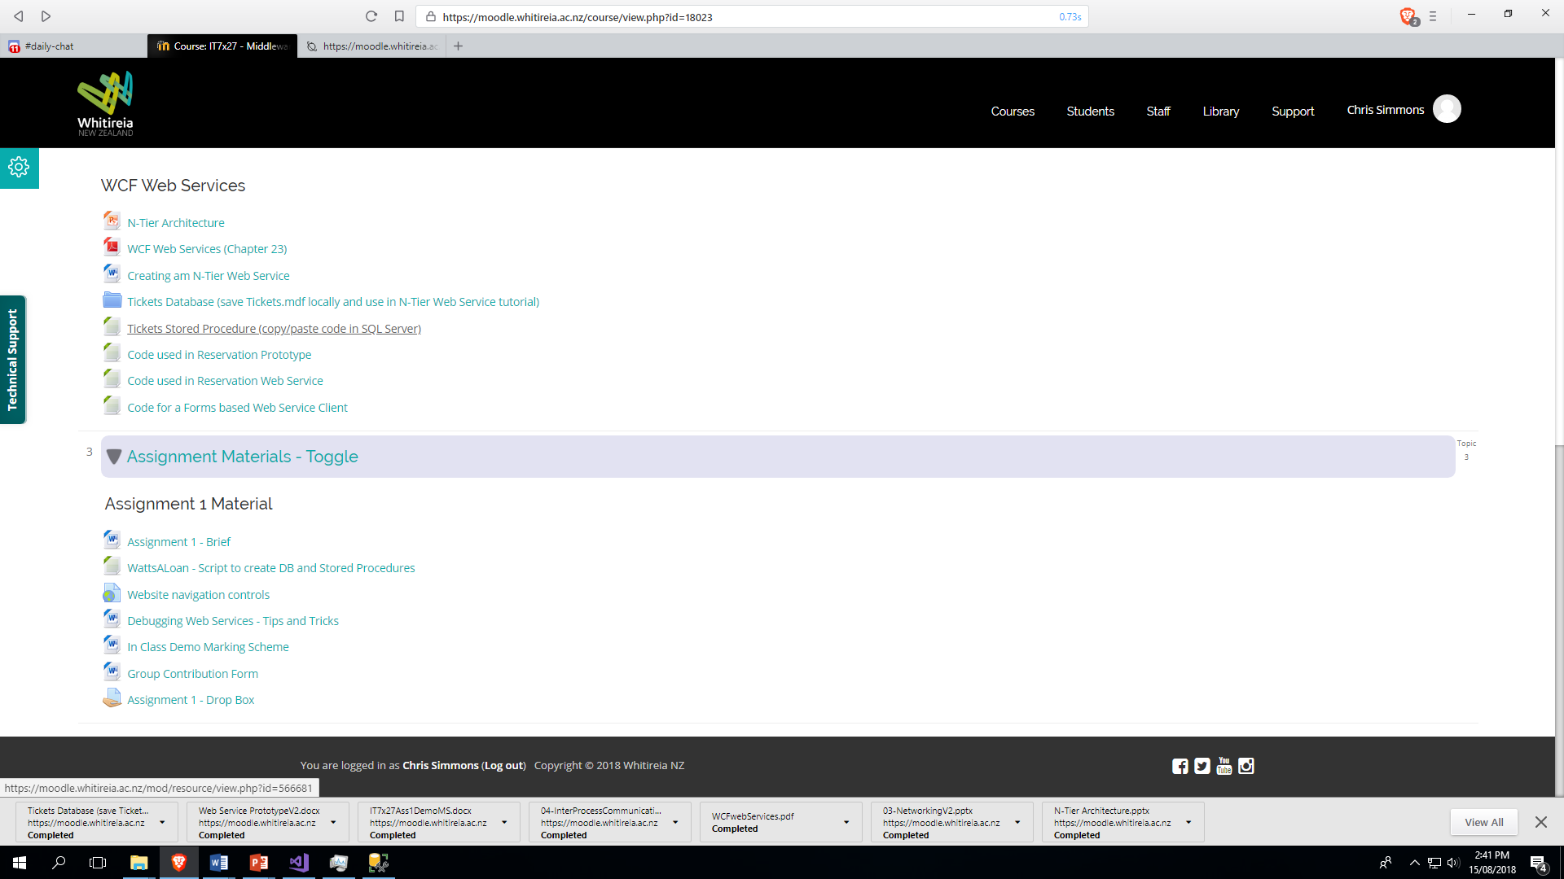

Slide 13
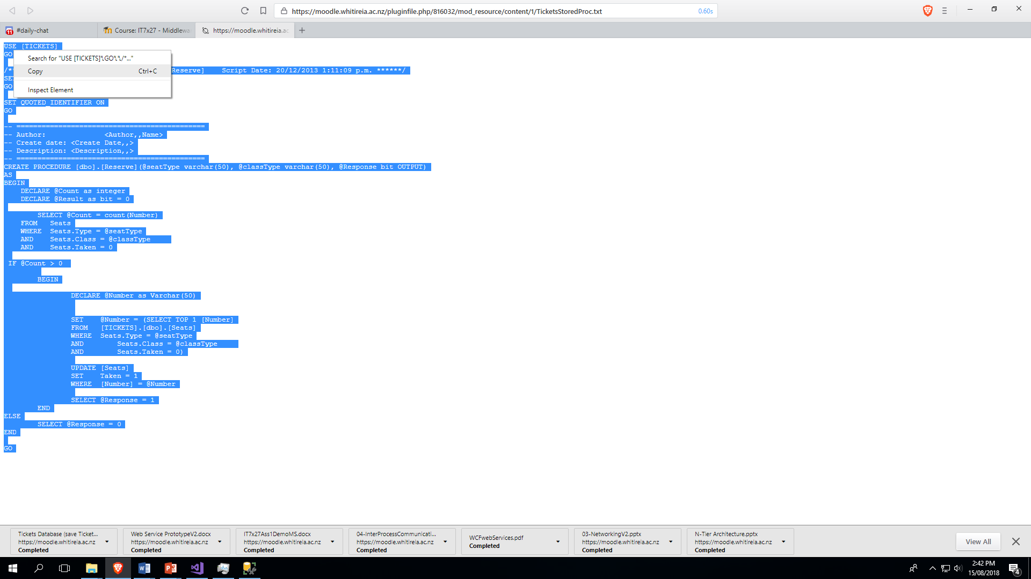

Slide 14
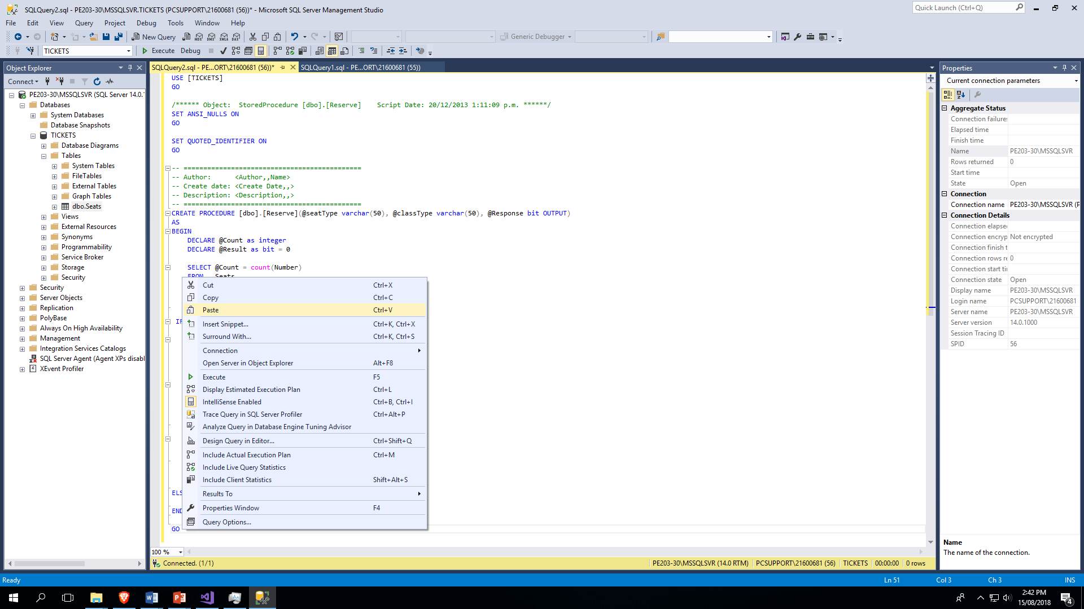

Slide 15
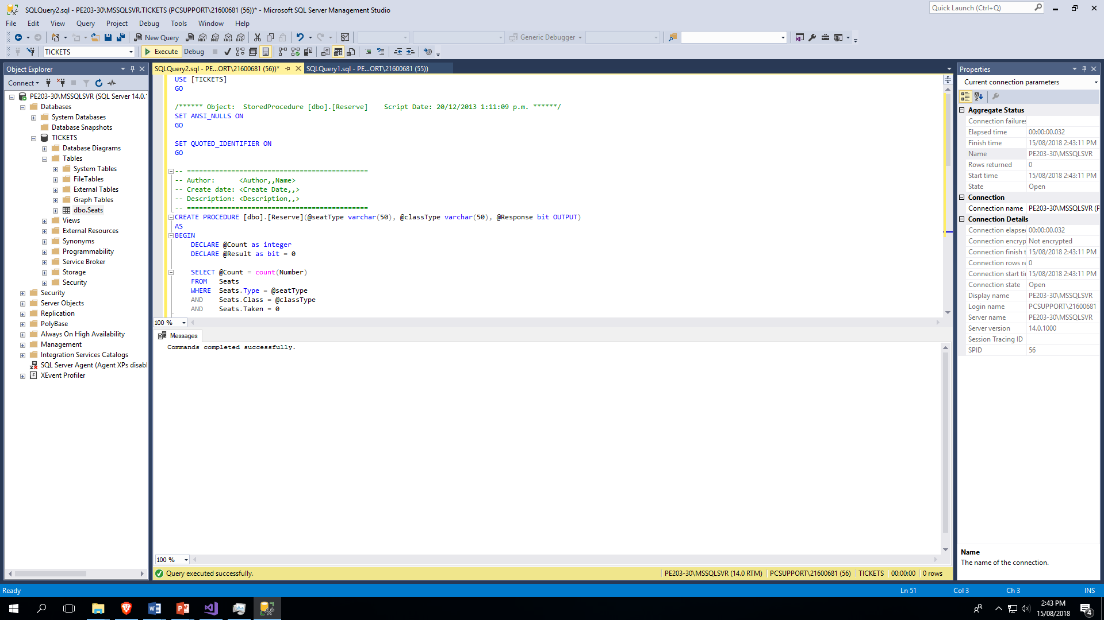

Slide 16
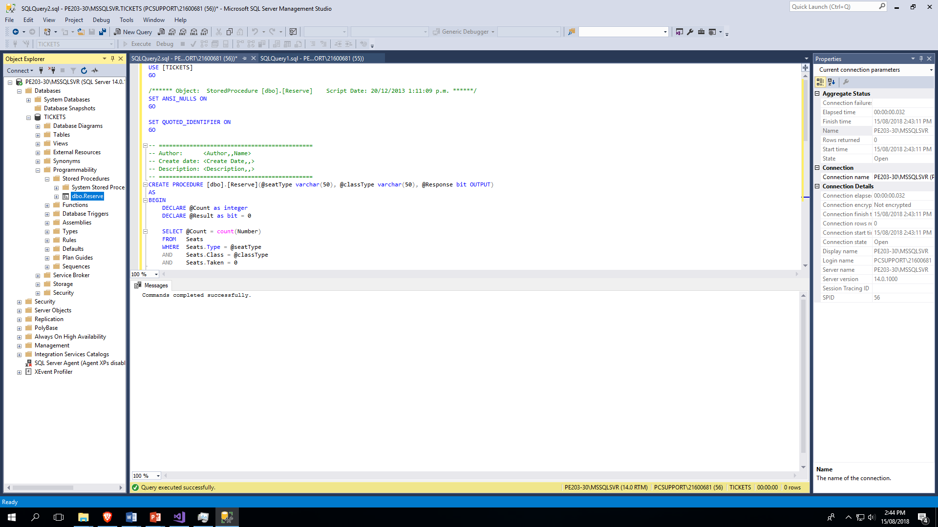

Slide 17
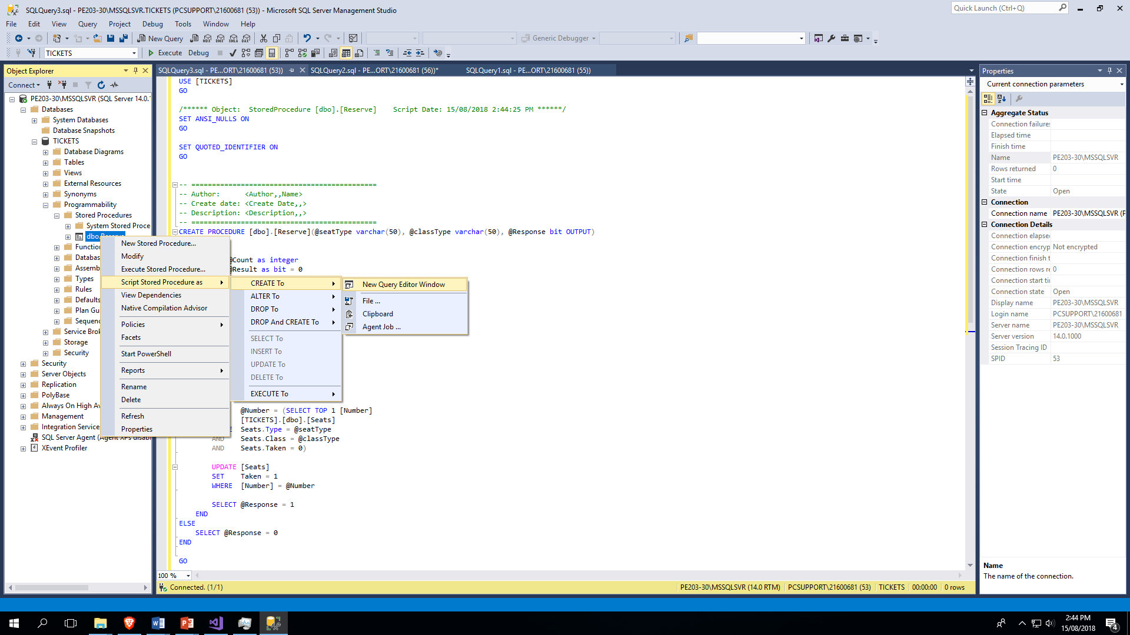

Slide 18
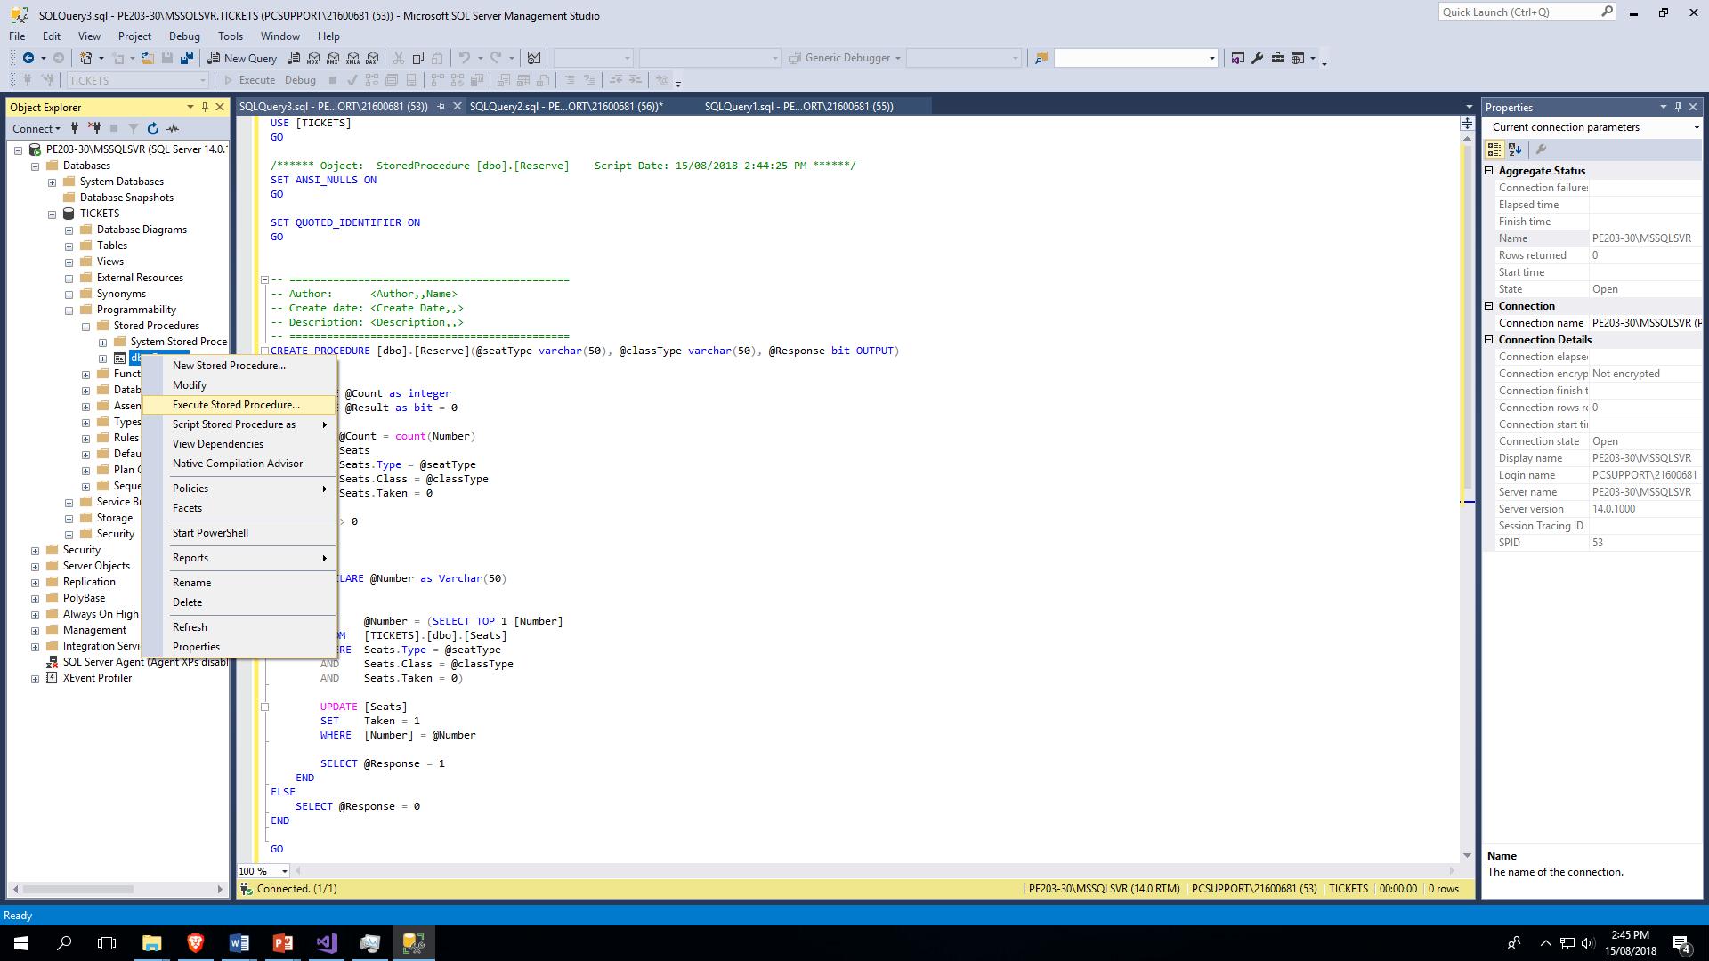

Slide 19
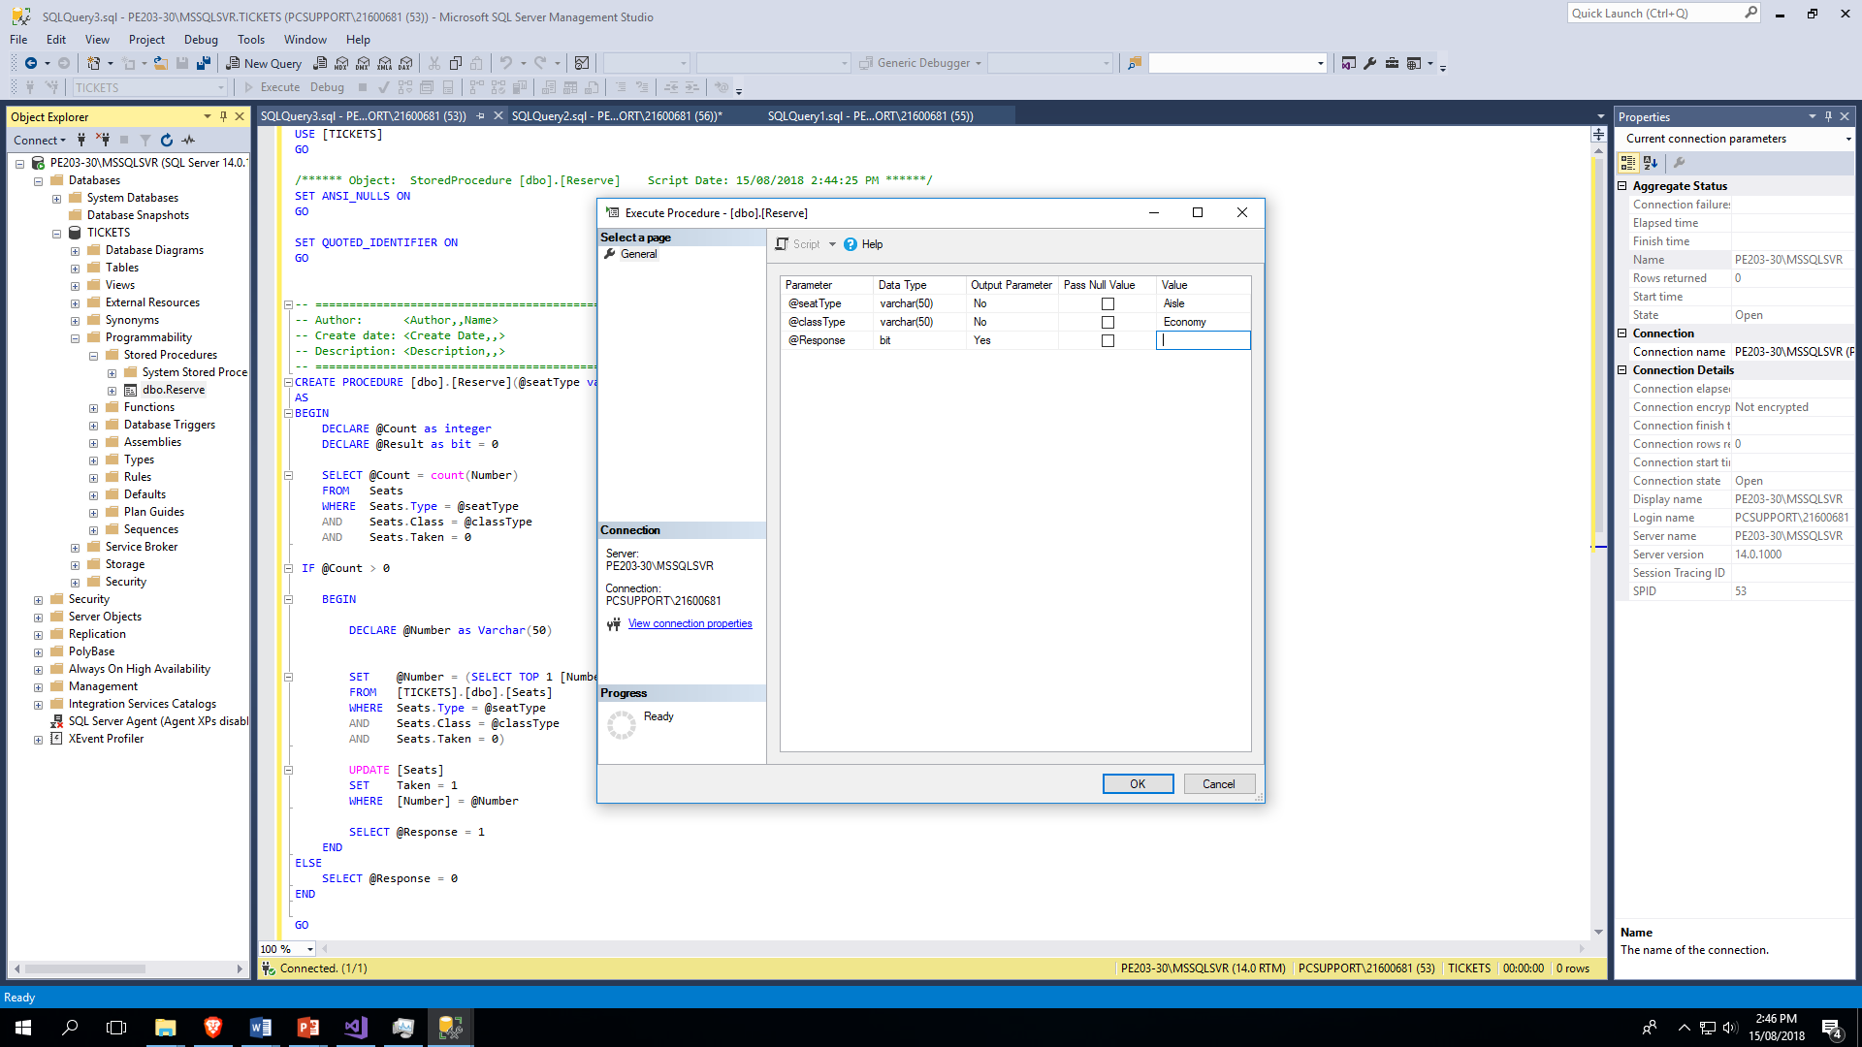

Slide 20
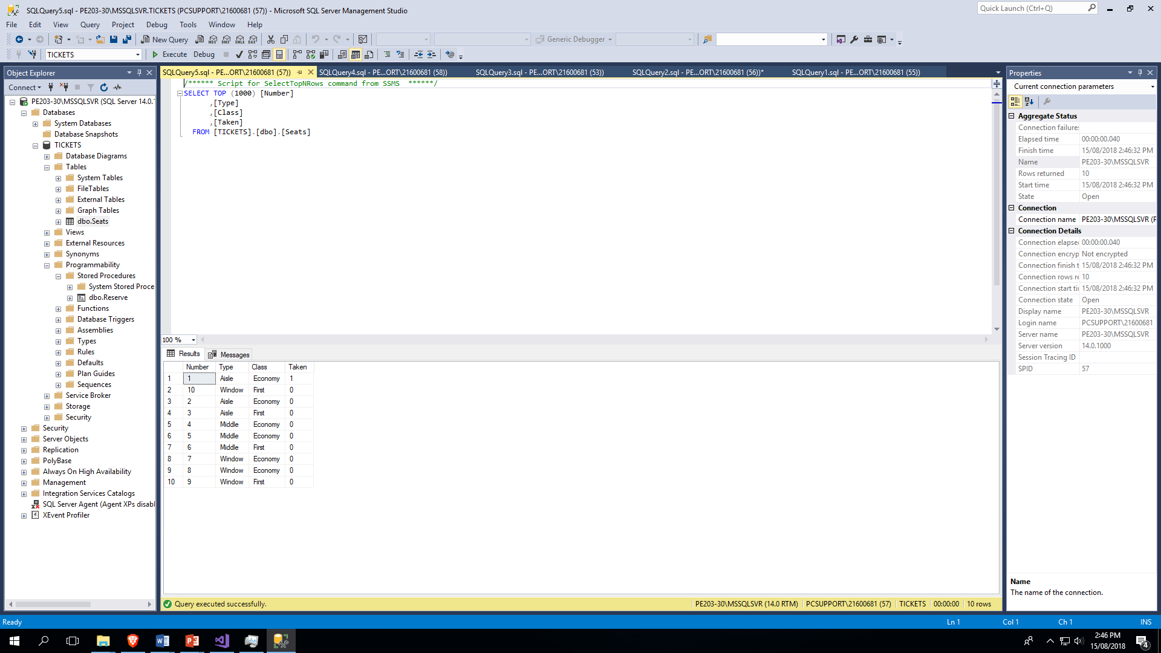

Slide 21
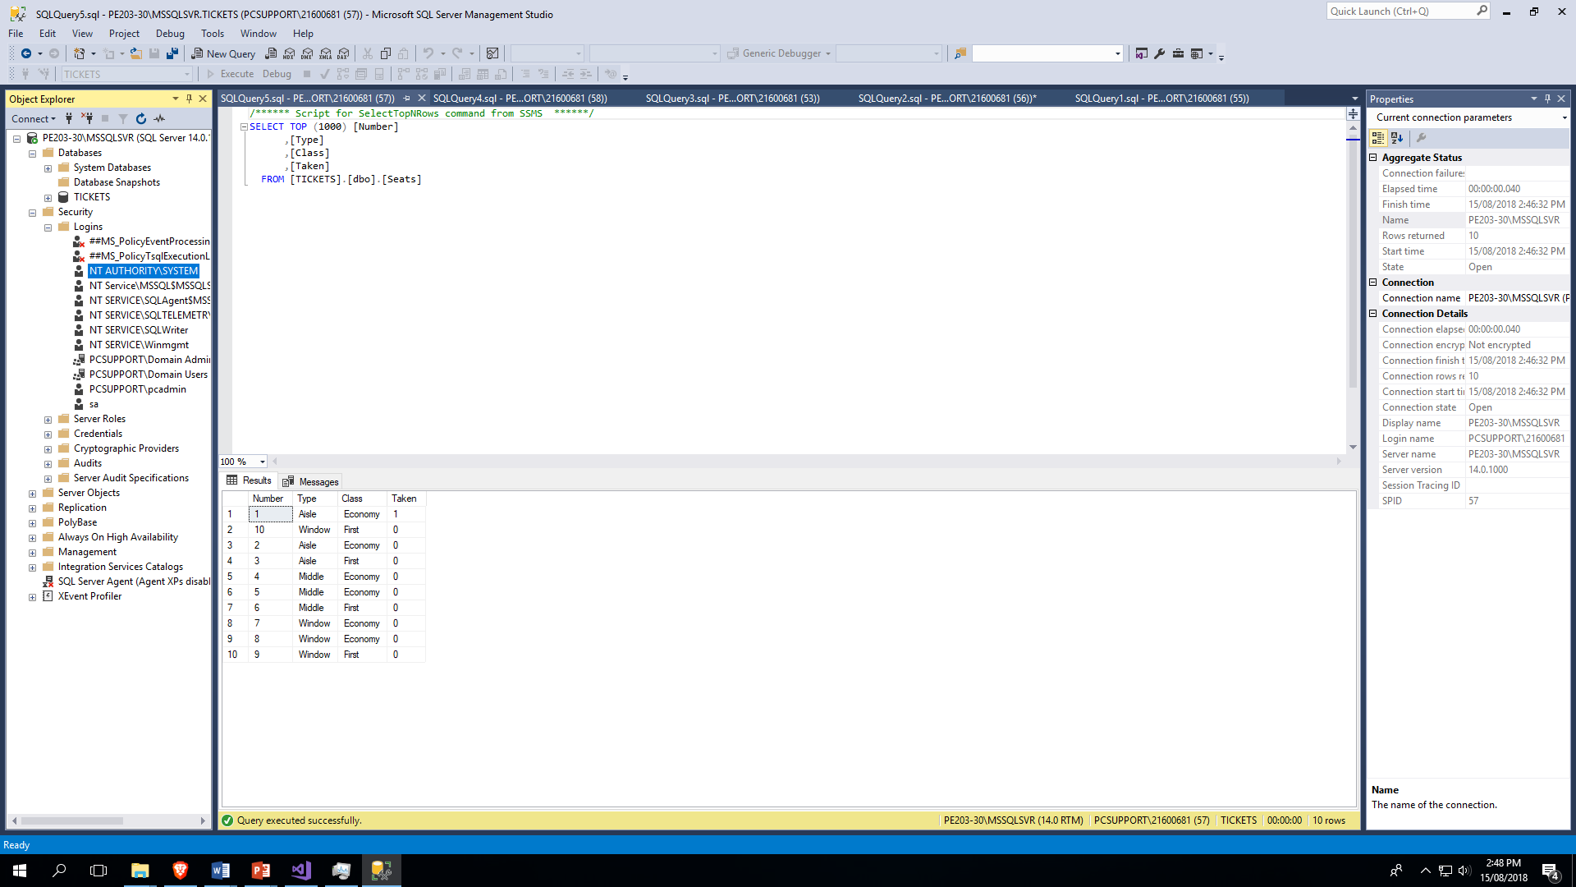

Slide 22
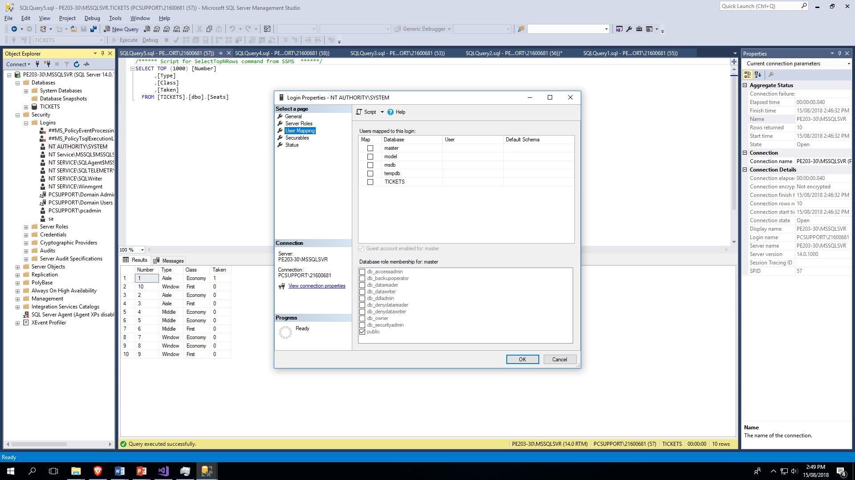

Slide 23
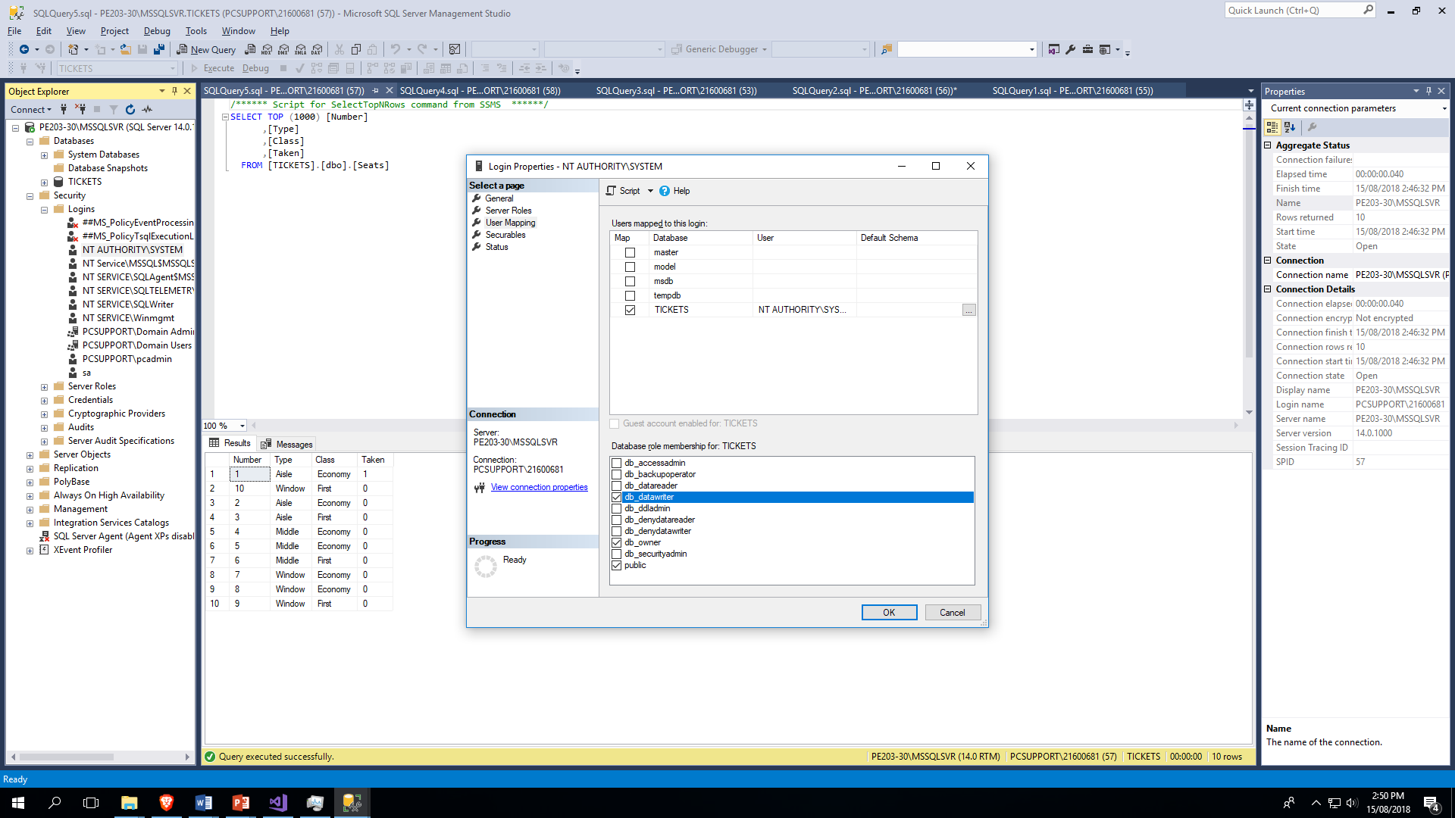

Slide 24
BACK END DONE

Slide 25
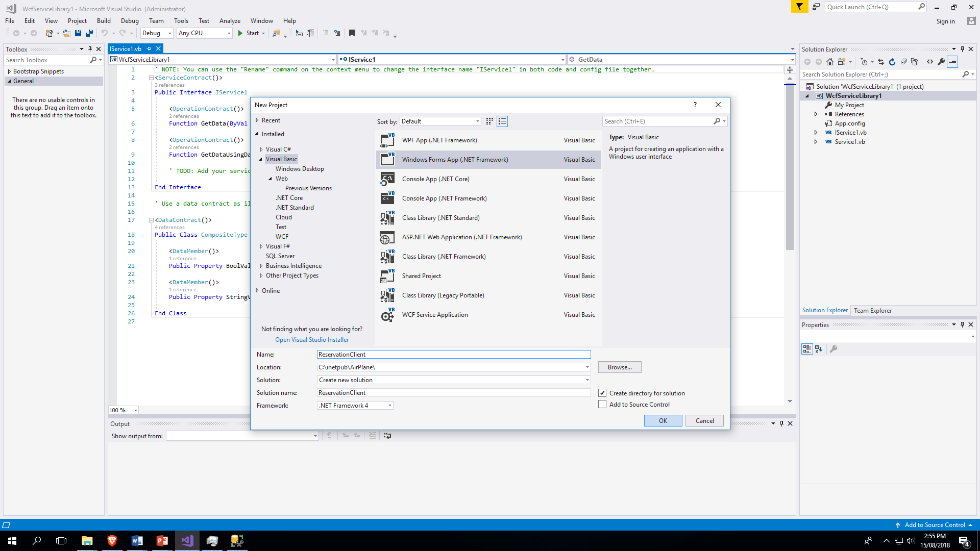

Slide 26
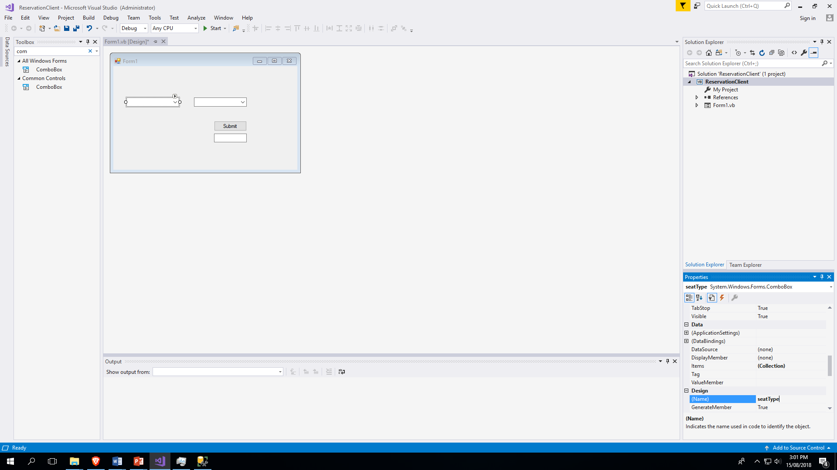

Slide 27


Slide 28
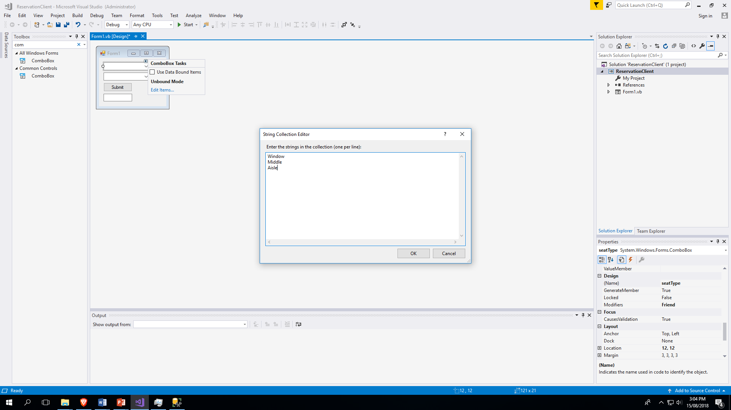

Slide 29
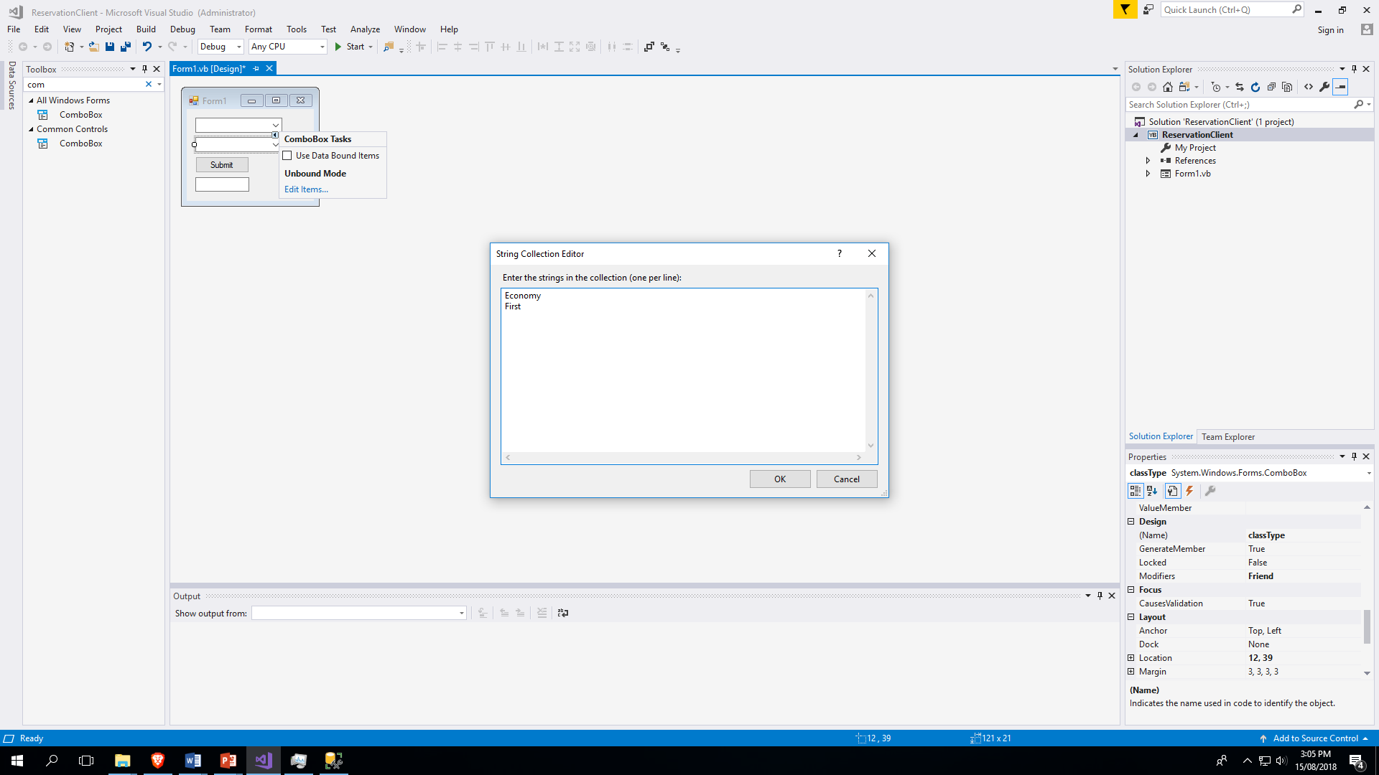

Slide 30
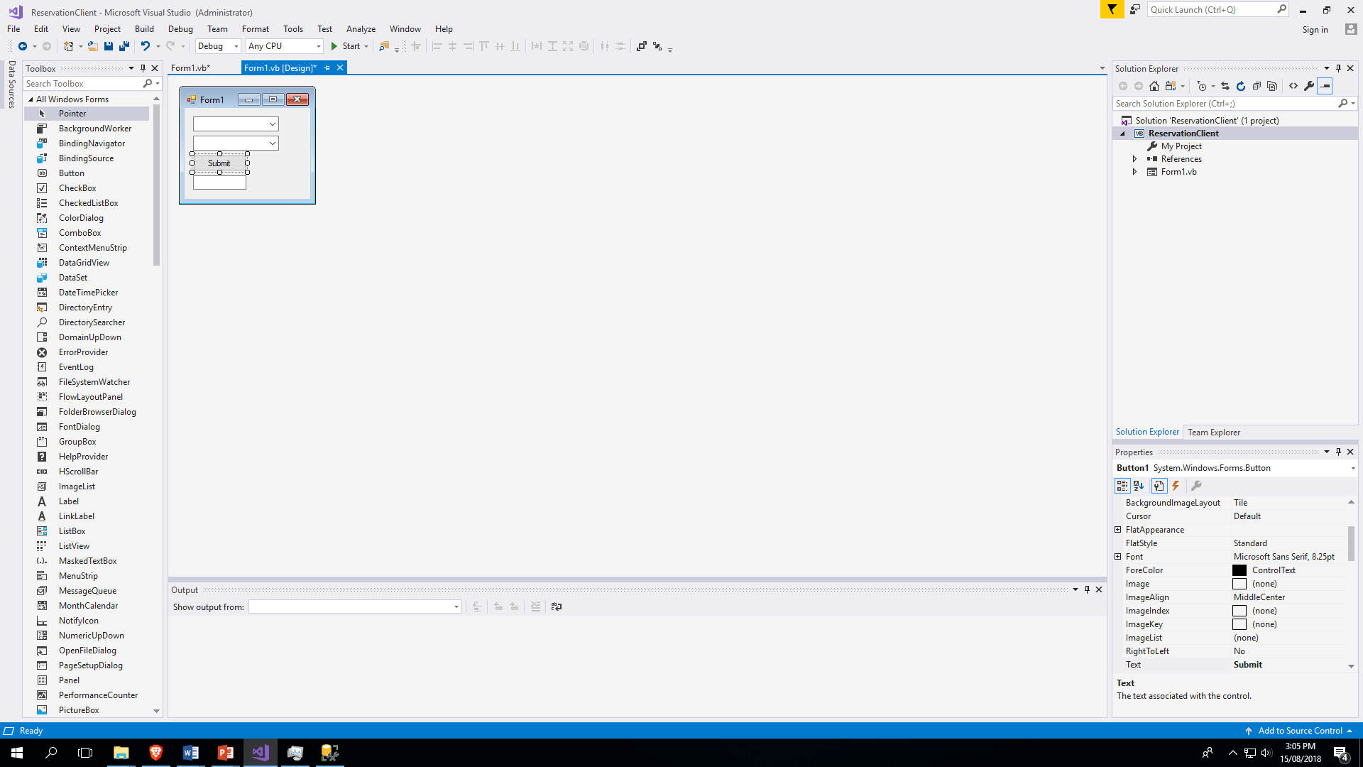

Slide 31
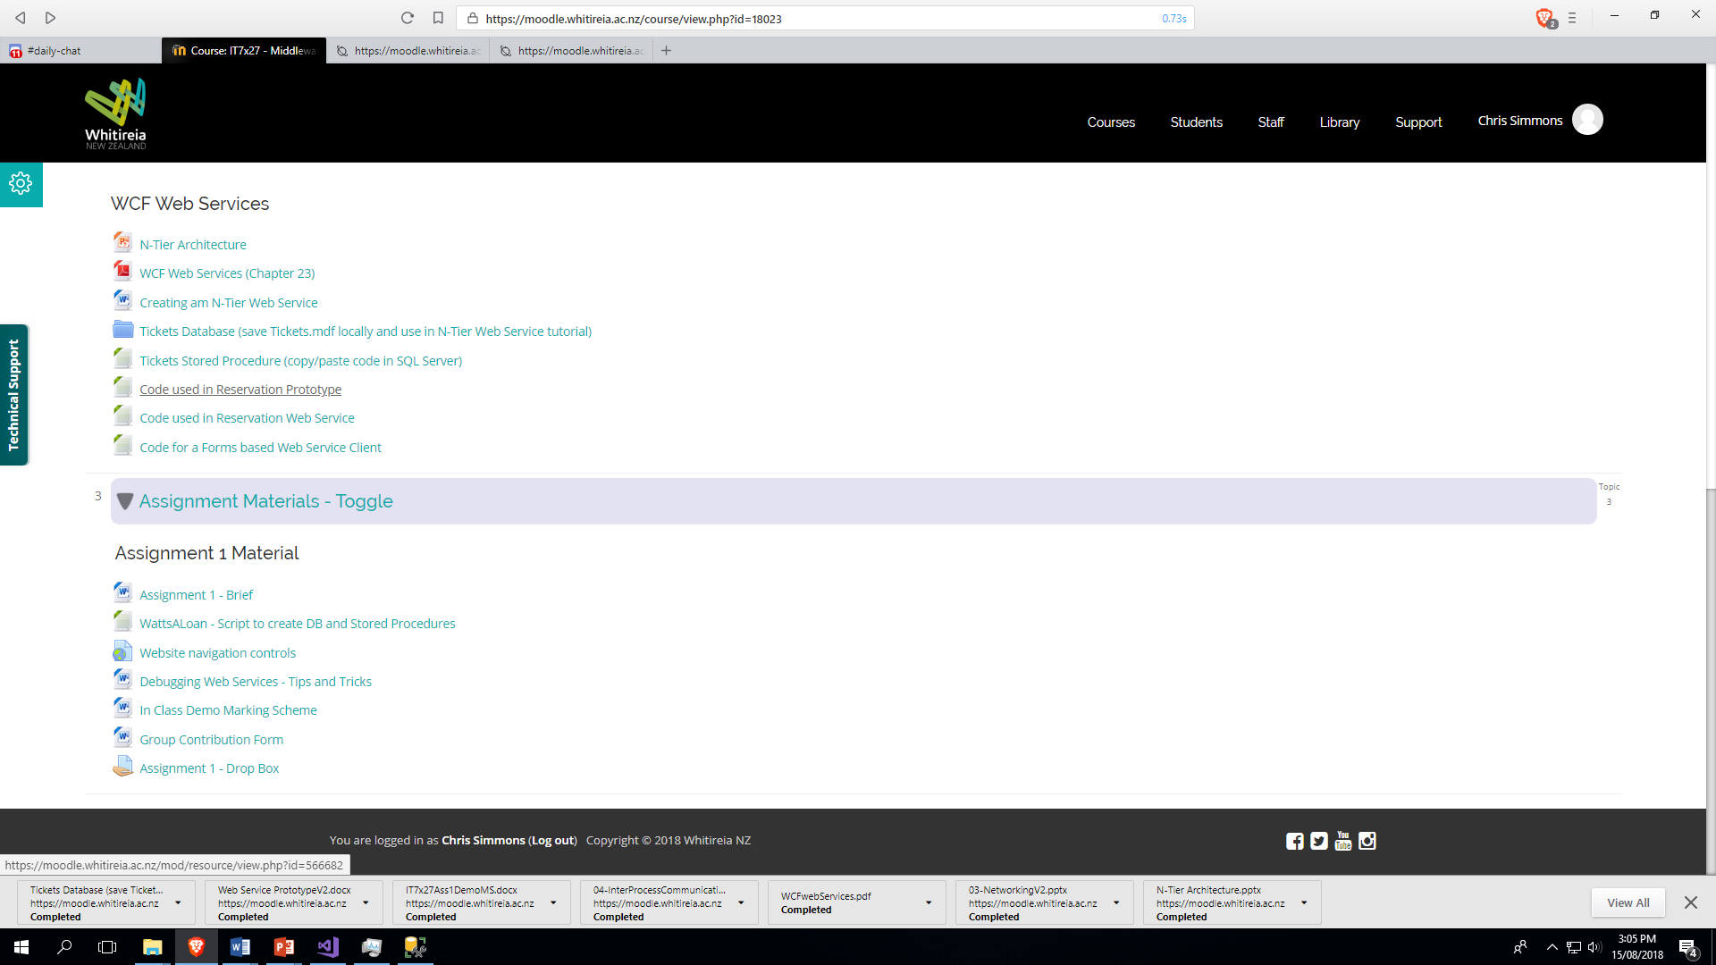

Slide 32
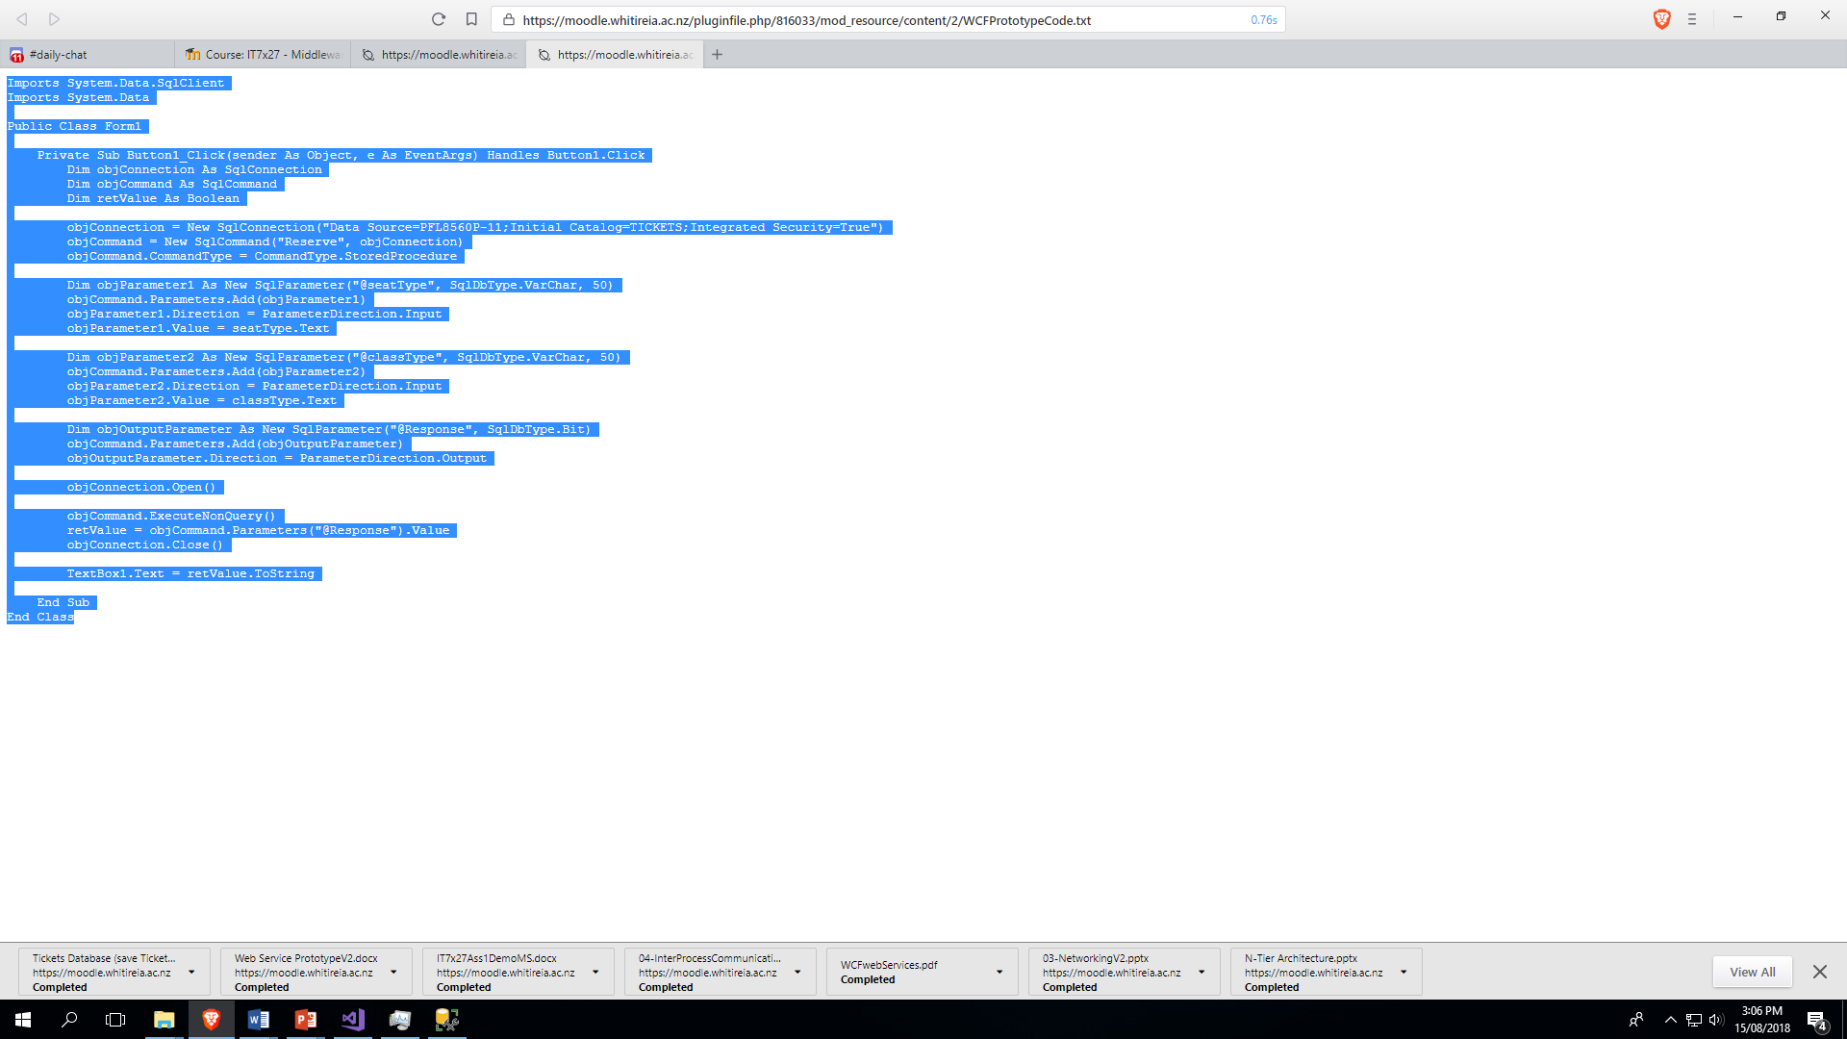

Slide 33
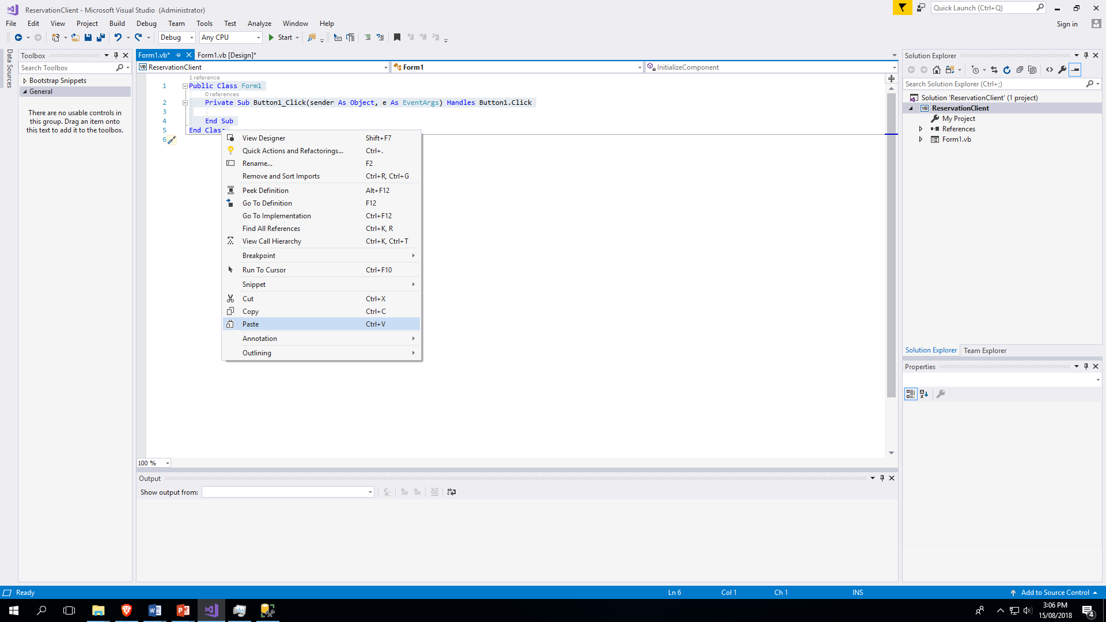

Slide 34
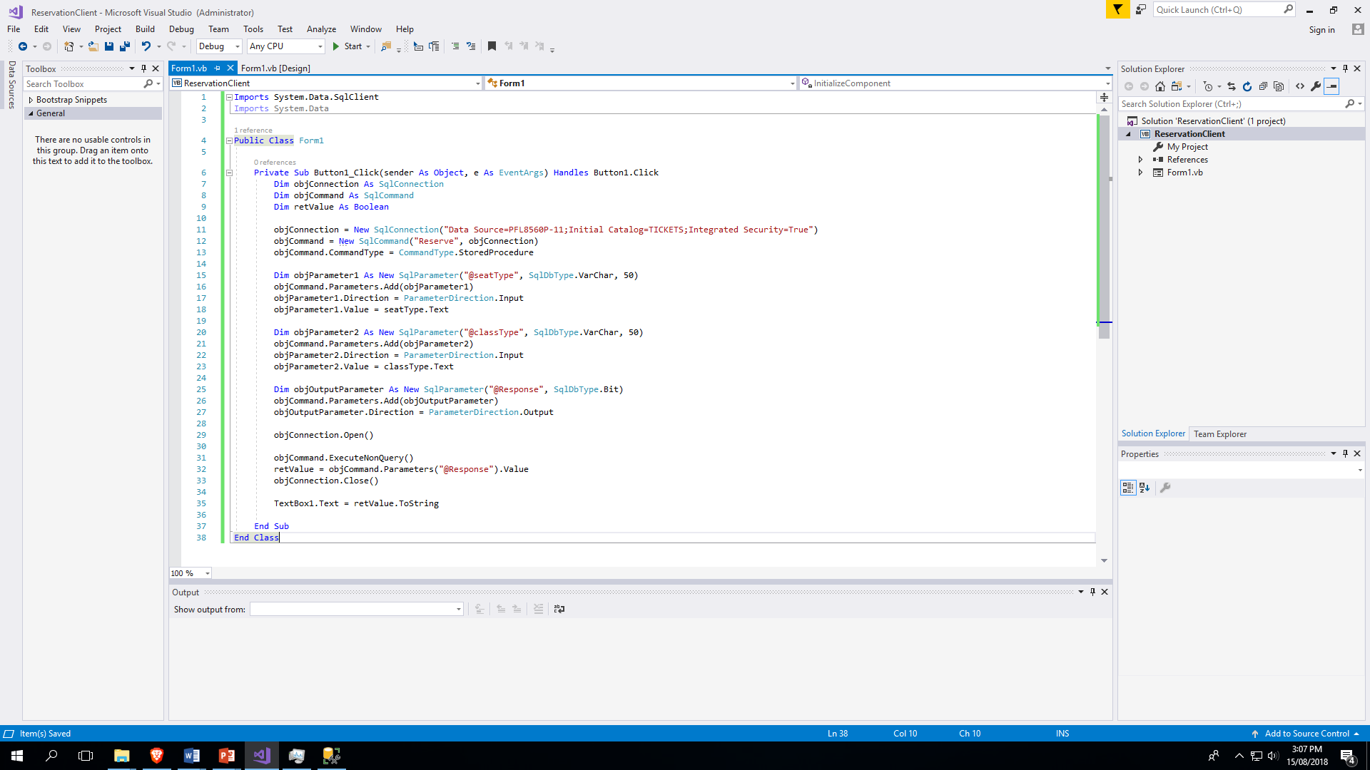

Slide 35
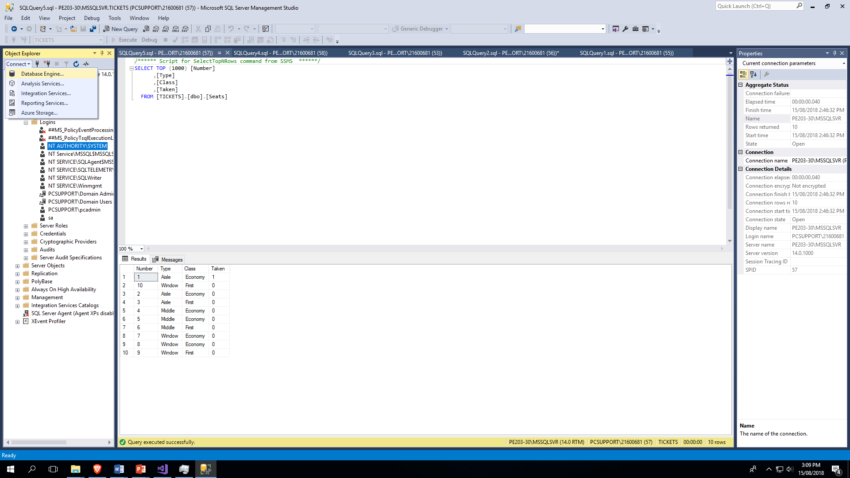

Slide 36
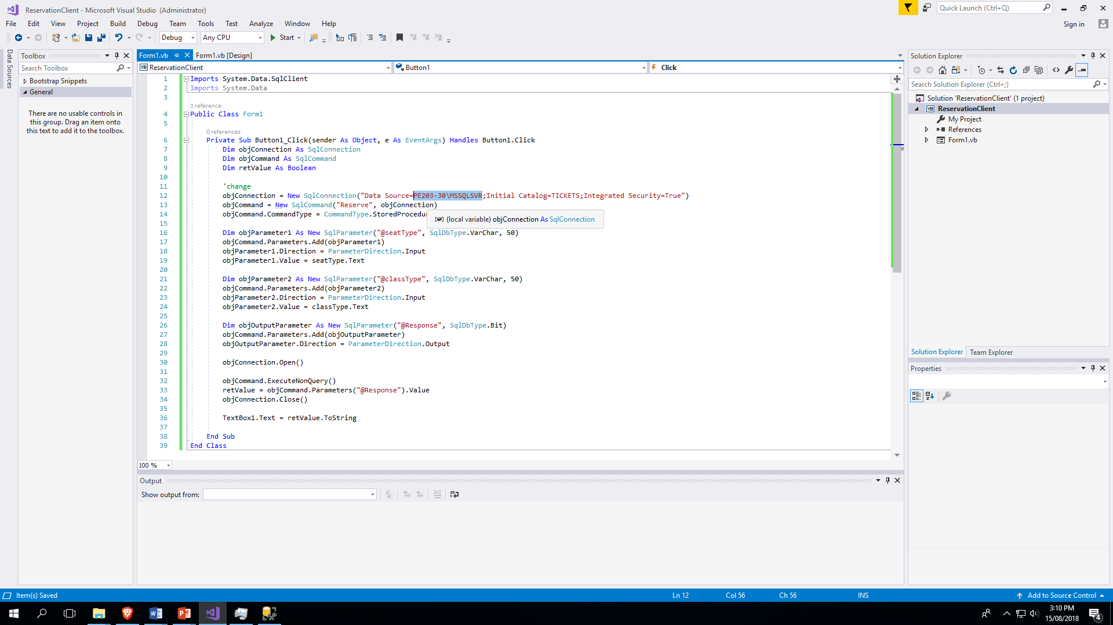
PE203-30\MSSQLSVR

Slide 37
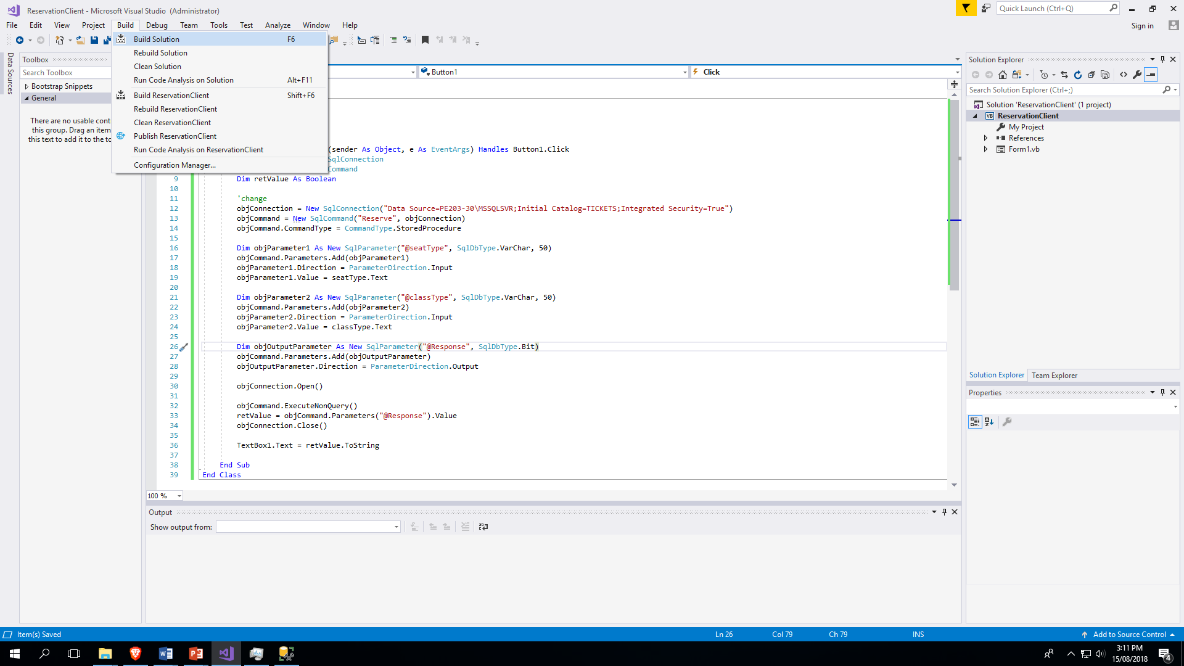

Slide 38
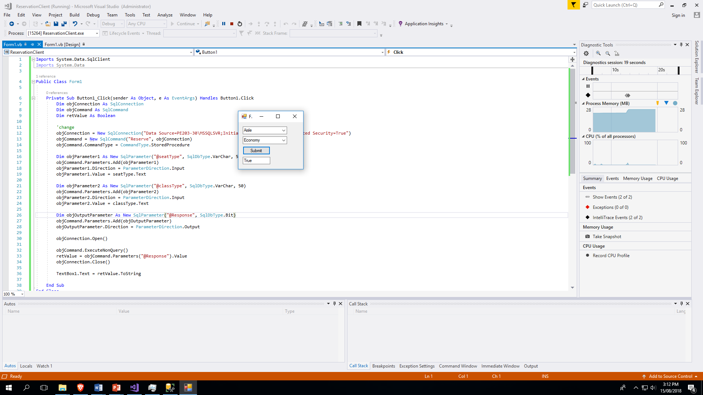

Slide 39
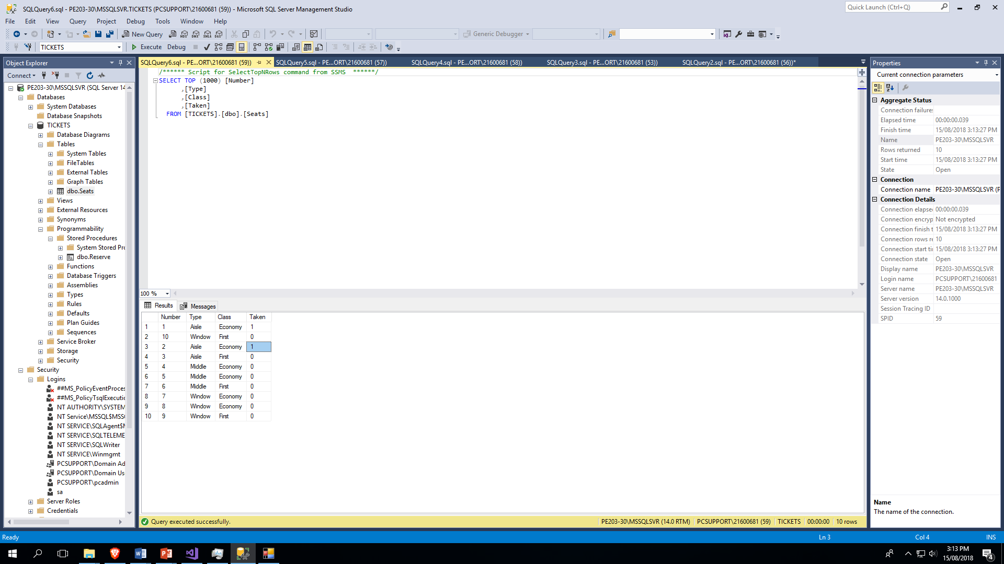

Slide 40
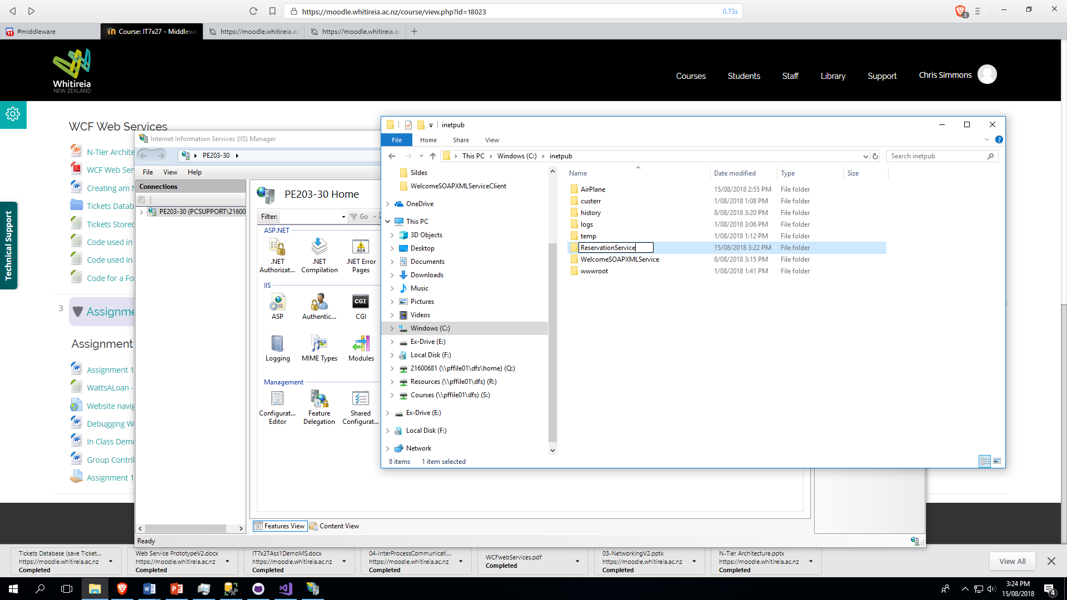

Slide 41
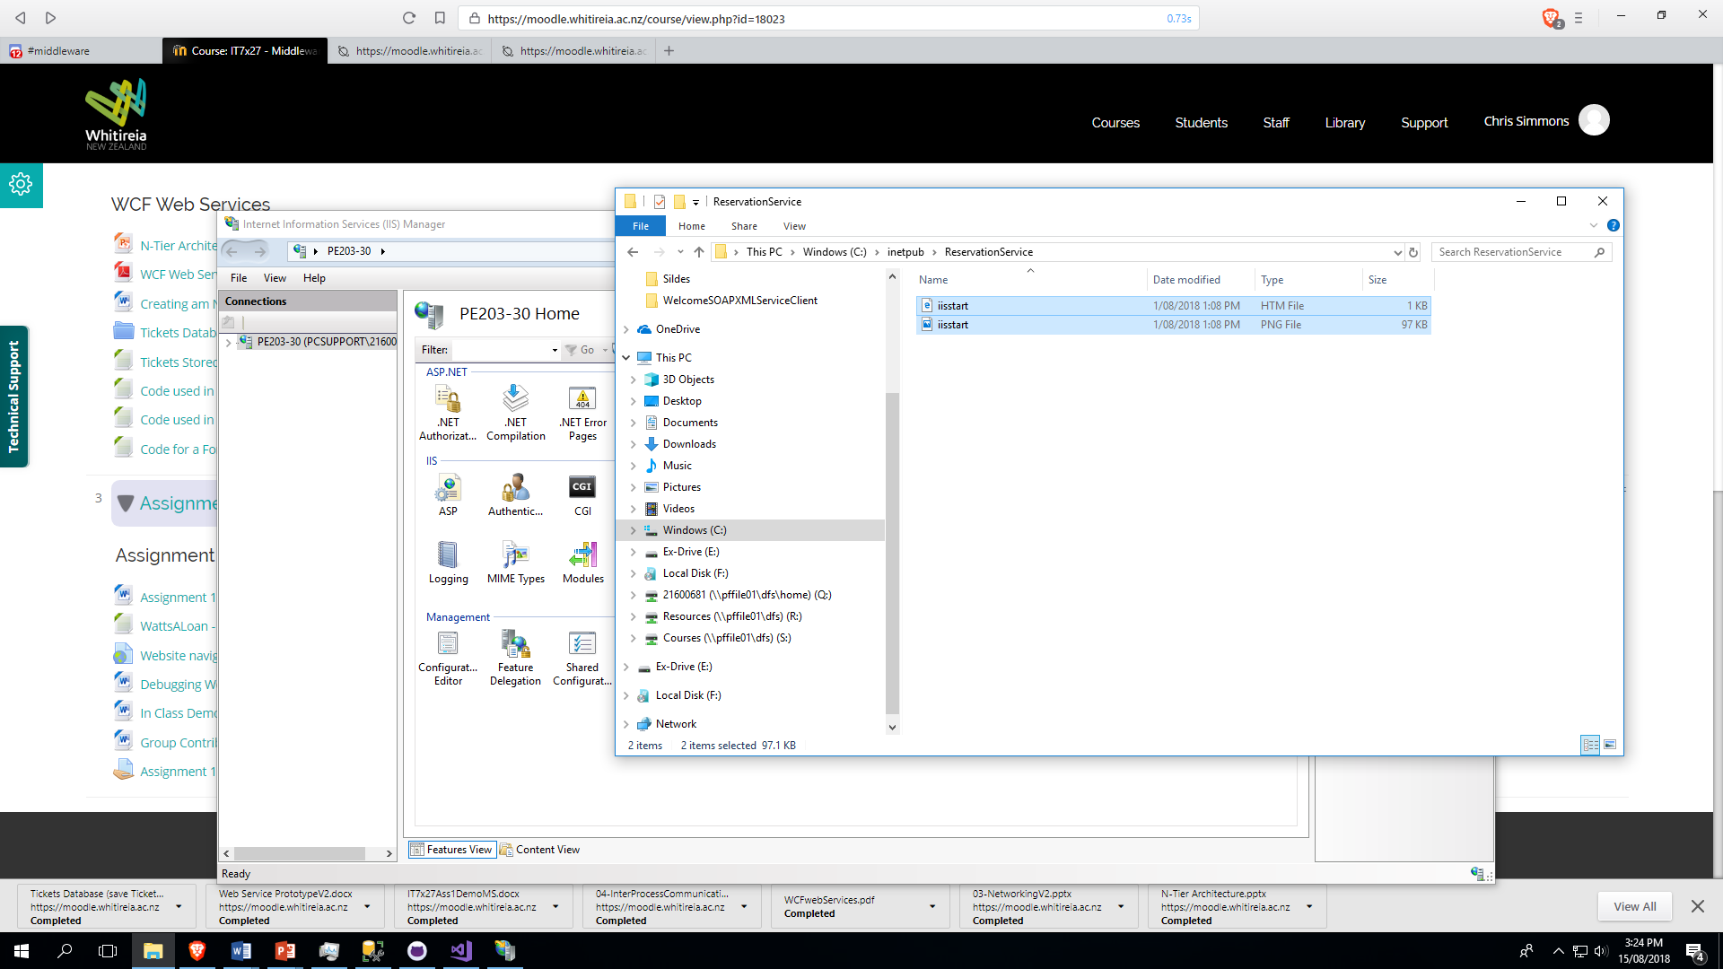

Slide 42
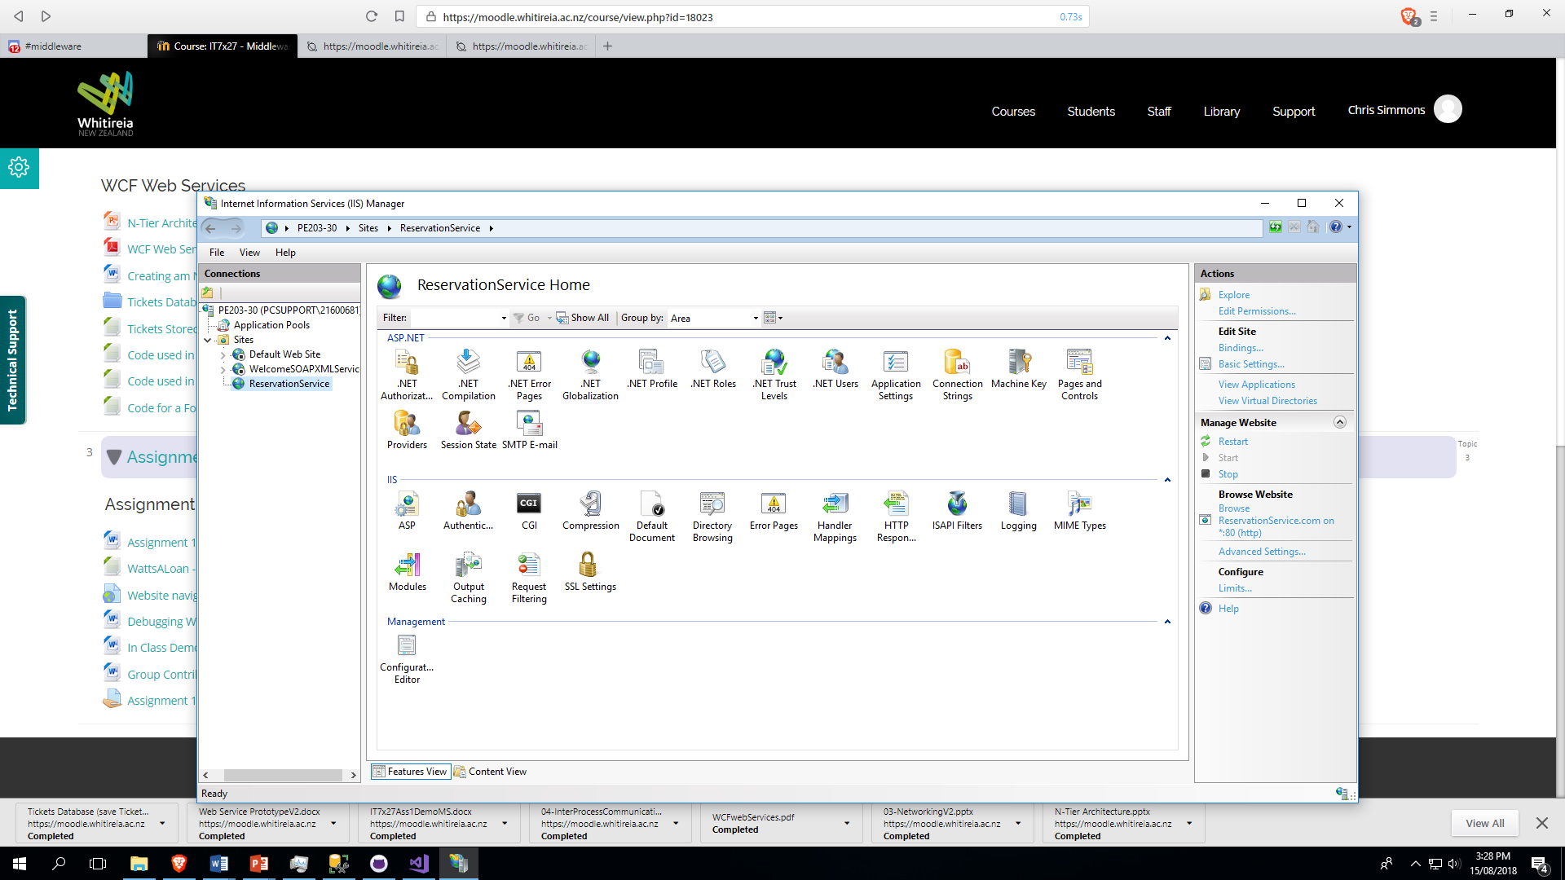

Slide 43
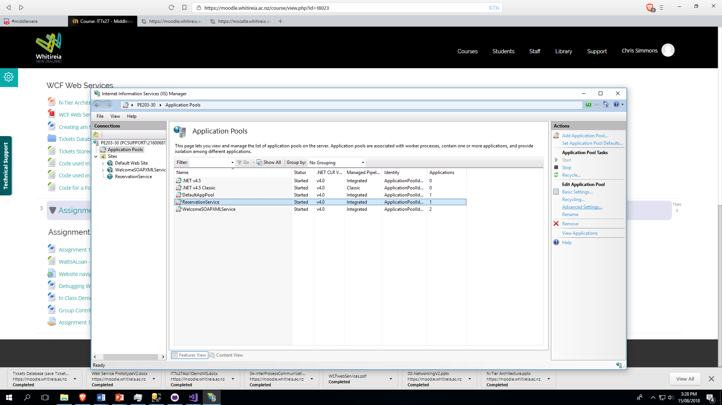

Slide 44
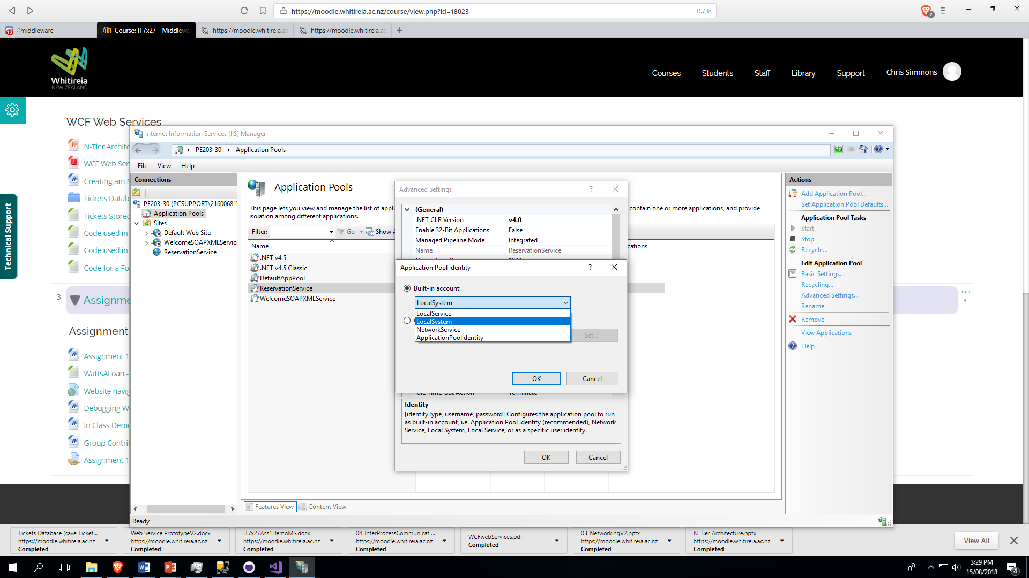

Slide 45
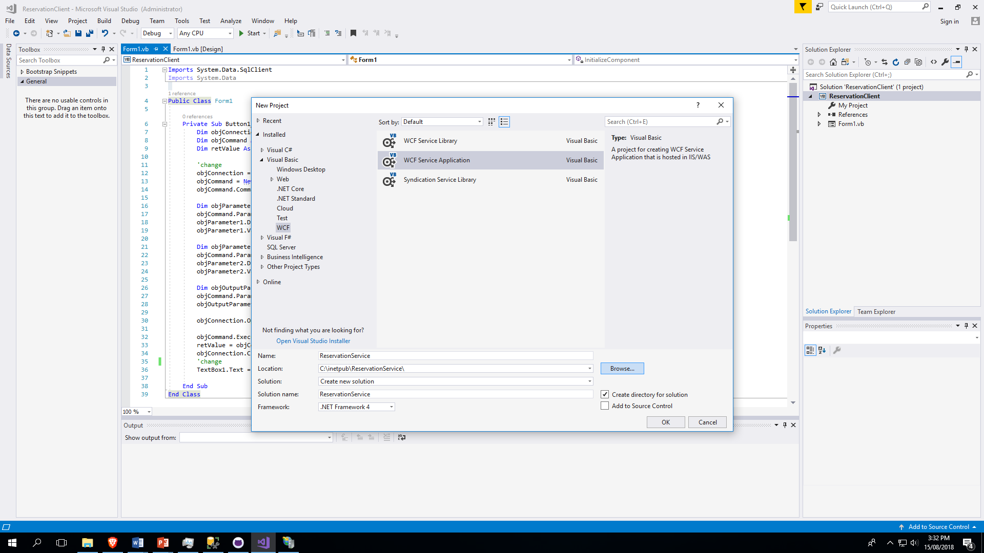

Slide 46
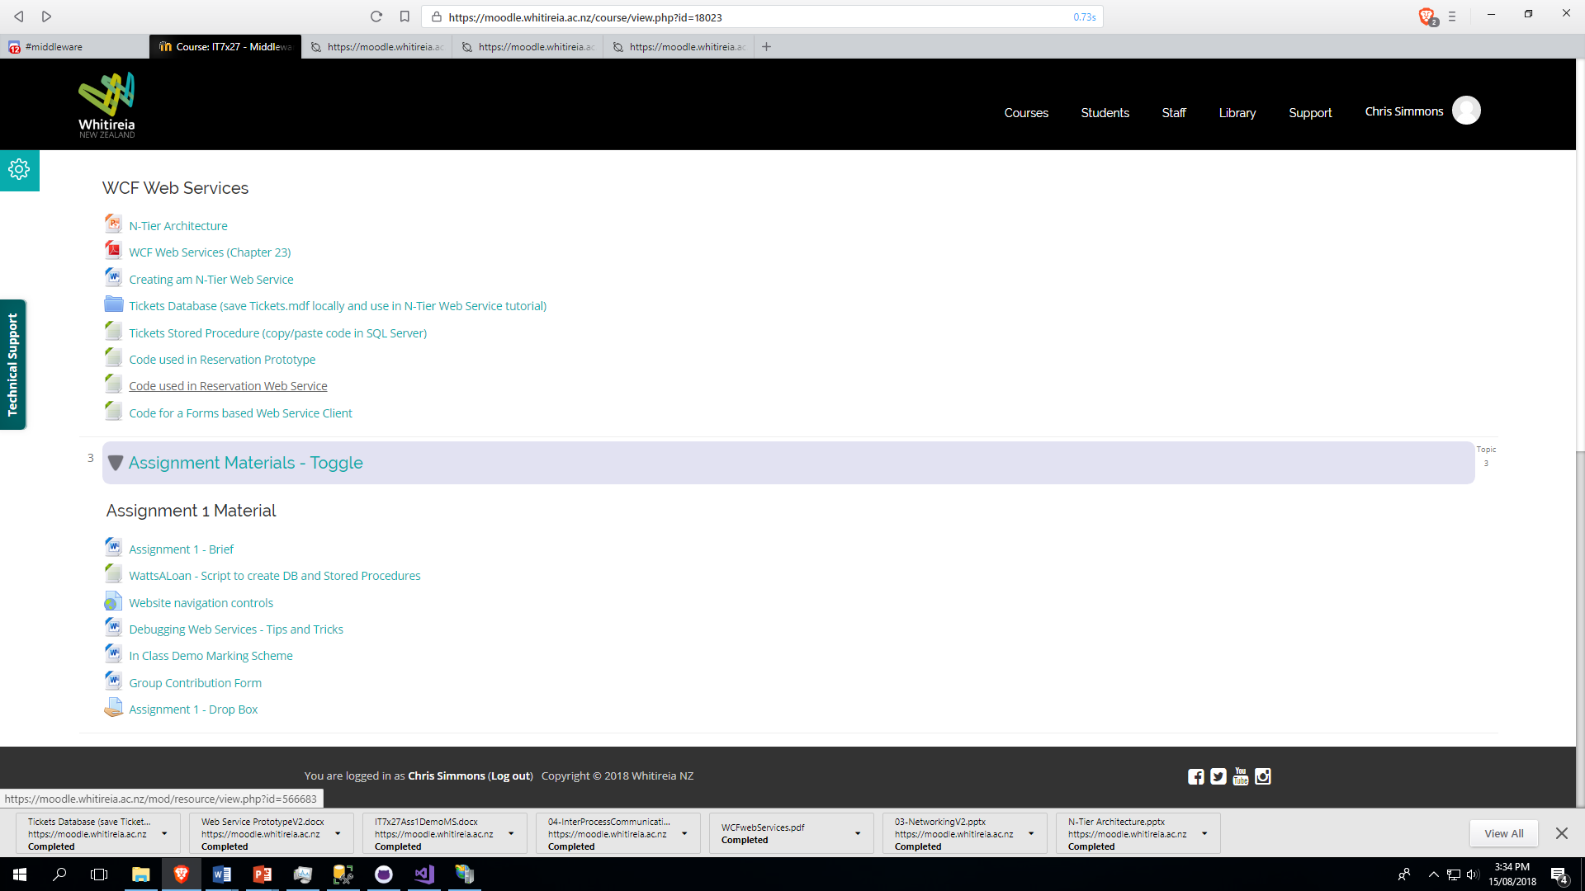

Slide 47
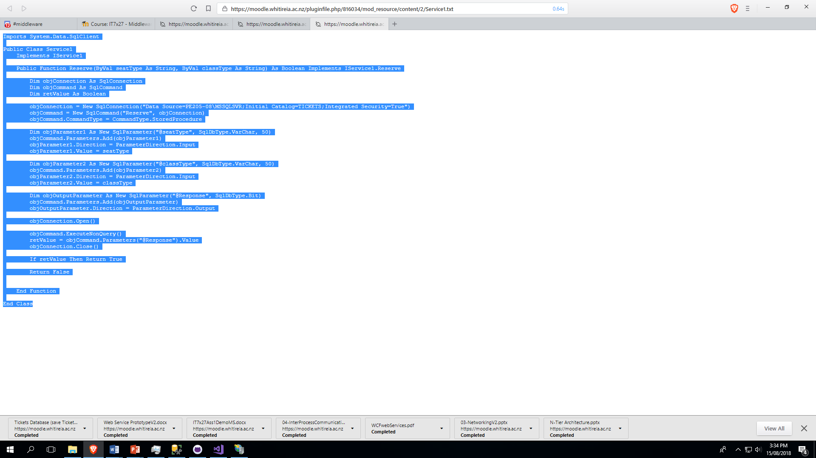

Slide 48
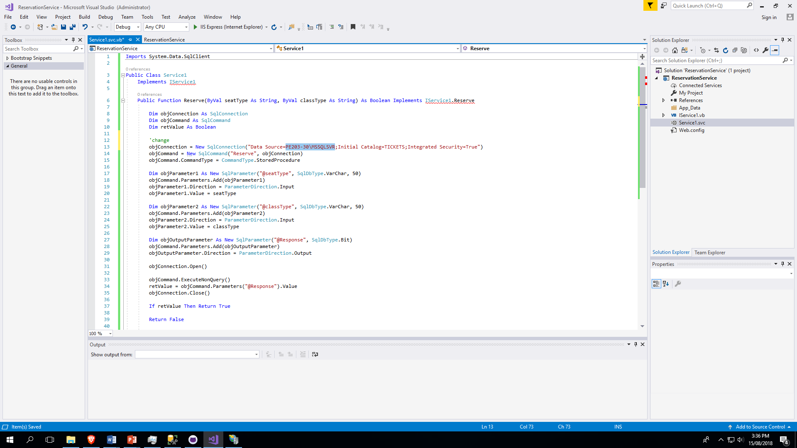

Slide 49
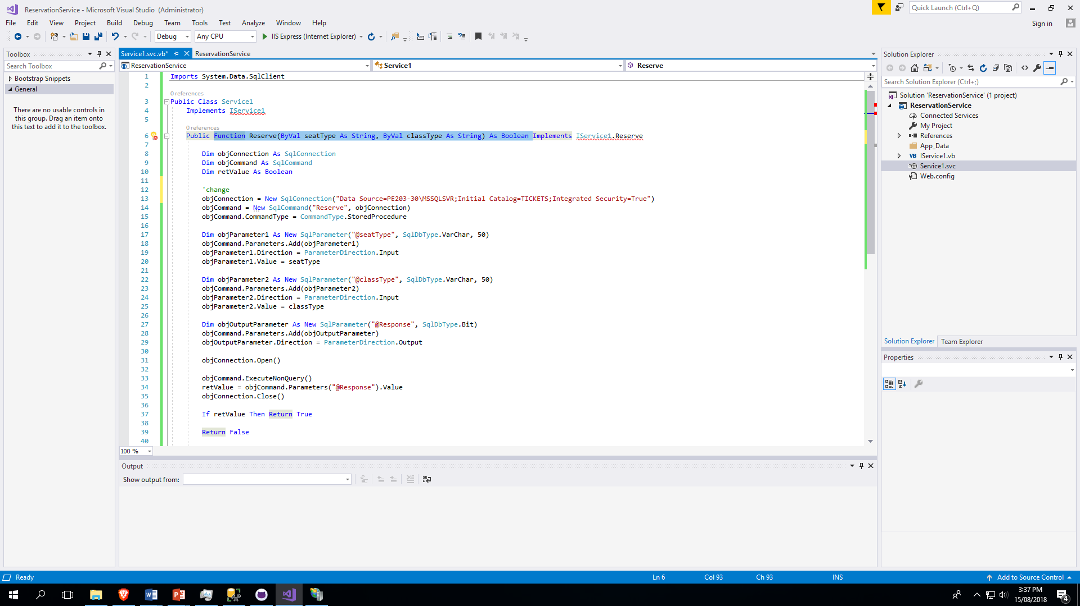

Slide 50
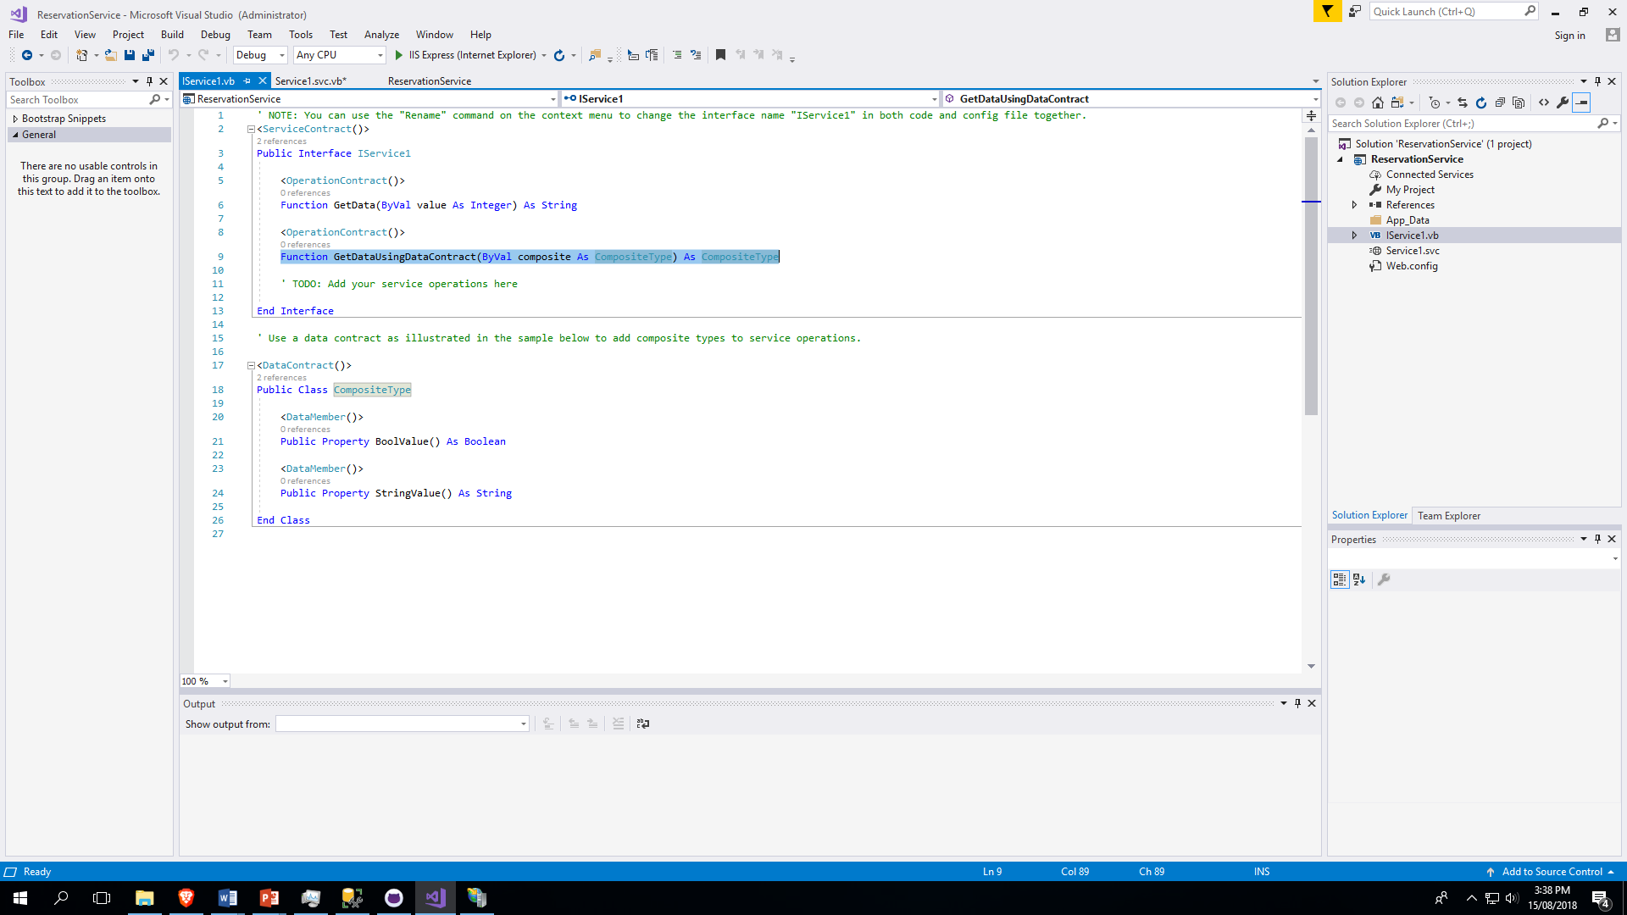

Slide 51
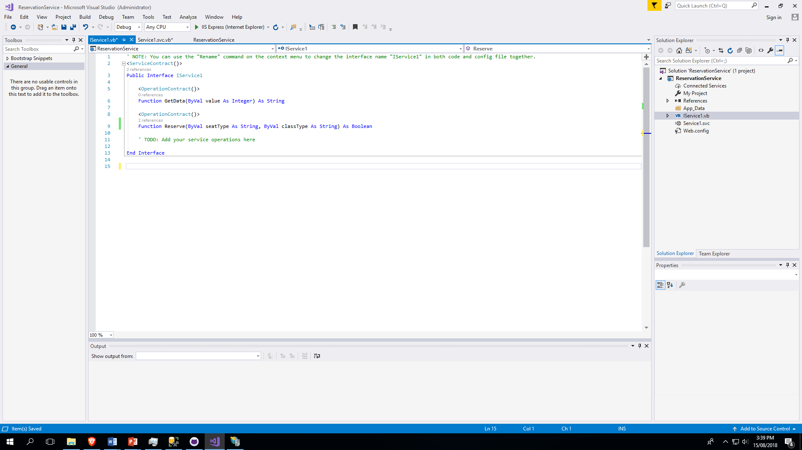

Slide 52
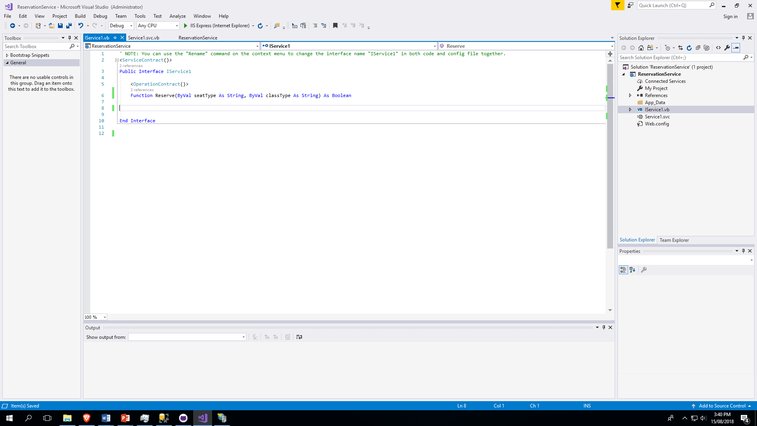

Slide 53
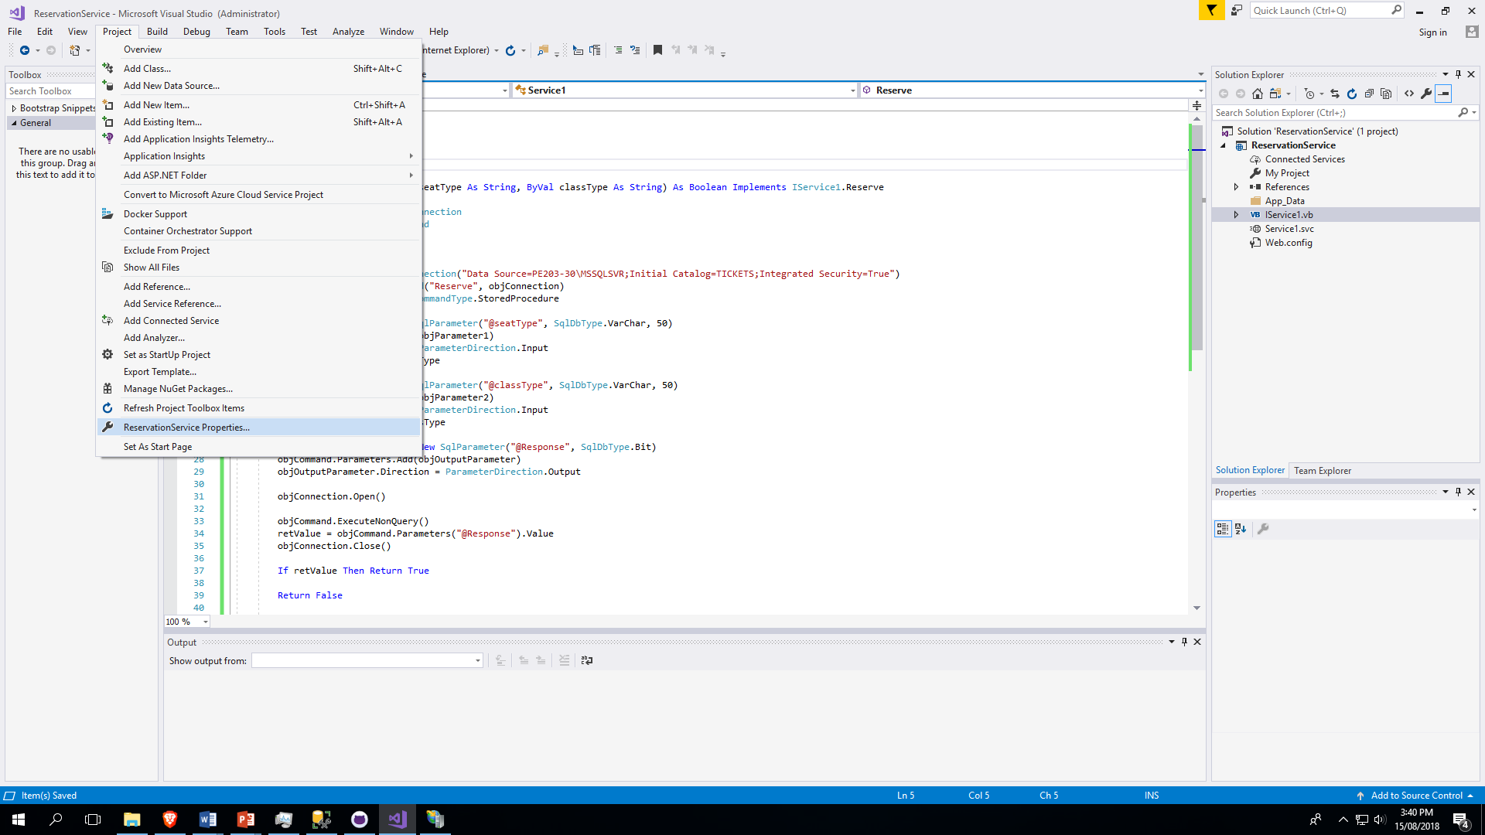

Slide 54


Slide 55


Slide 56


Slide 57


Slide 58


Slide 59


Slide 60


Slide 61


Slide 62


Slide 63


